Slide 1
Reproduction Review for Test
Hold up white boards with responses only when told to do so!

Slide 2
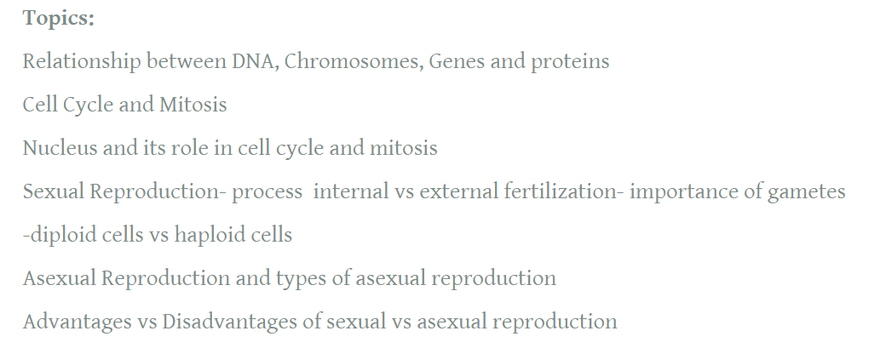
Test Content: 30 Multiple Choice
18 marks Written

Slide 3
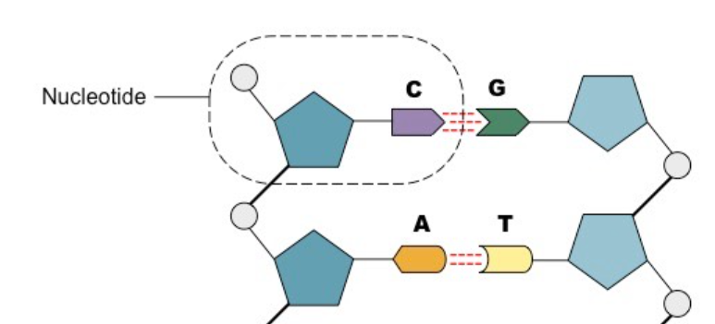
What substances make up a nucleotide?
-Phosphate
-Sugar (deoxyribose) -Nitrogen bases

Slide 4
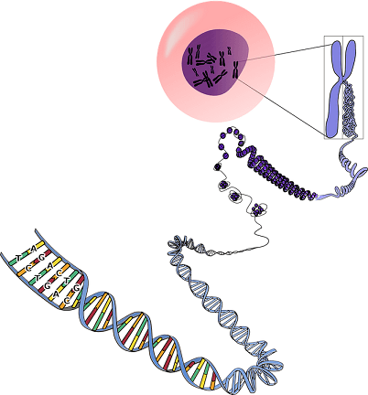
What is the difference between a chromosome and chromatin?
A chromosome is tightly coiled replicated DNA - X shaped
-Chromatin is unravelled DNA that may or may not be replicated

Slide 5
What is the DNA strand that pairs with:
ATC AGT CAA TGC CAG
TAG TCA GTT ACG GTC

Slide 6
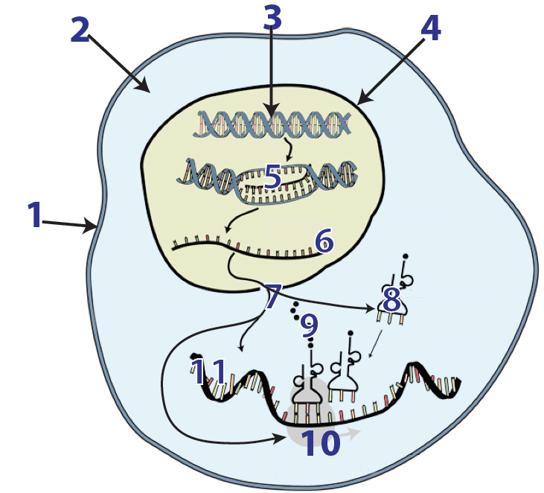
What is this diagram showing?
Protein Synthesis

Slide 7
What structure (6) is able to leave the nucleus??
Messanger RNA

Slide 8
What structure (10) translates the code into a protein?
Ribosome

Slide 9
What structure produces ribosomes and where is this structure located in a cell?

Slide 10
The nucleolus in the nucleus

Slide 11
Protein building blocks are (9)?
Amino Acids

Slide 12
What are two roles of proteins?

Slide 13
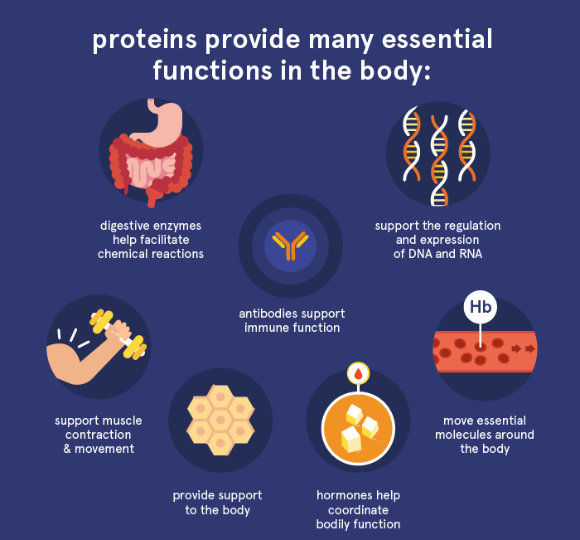

Slide 14
How does DNA and genes control the function and role of a cell?
DNA contains different genes that store information that codes for different proteins. In different cells only specific genes are turned on. The genes that are turned on code for proteins necessary for that cell type to function properly.

Slide 15
What is one reasons why cells need to reproduce to produce identical copies?
To replace dead or injured cells
To reproduce an asexual organism
For an organism to grow bigger

Slide 16
What are the stages of the cell cycle?
Interphase, mitosis and cytokinesis

Slide 17
What is the longest phase of the cell cycle during which DNA is replicated?
Interphase

Slide 18
What is the purpose of mitosis?
To divide the cell’s nuclear material

Slide 19
What are the phases of mitosis?
Prophase, metaphase, anaphase, and telophase

Slide 20
What is one event that happens during telophase?
-A nuclear membrane forms around each set of chromosomes
-Nucleolus reappears
-Chromosomes uncoil to become chromatin

Slide 21
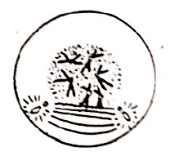
What phase of mitosis is the image in? How do you know?
Prophase – spindle fibres are forming and chromosomes are x shaped and still enclosed in the nucleus

Slide 22
In anaphase the tugging action of the spindle fibres pulls the x-shaped chromosomes into a single line across the middle of the cell. True/False?
False

Slide 23
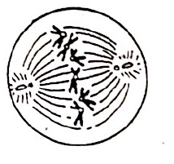
What phase of cell division is shown?
Metaphase

Slide 24
What phase of cell division occurs before cytokinesis in mitosis?
Telophase

Slide 25
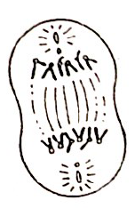
What stage of mitosis is this cell in?
Anaphase

Slide 26
Provide at lease one advantage of asexual reproduction.
No energy to find mate
Large number of offspring
100% of DNA passed on to offspring

Slide 27
What type of cells reproduce asexually?
Plant cells (like leaf or root cells)
Somatic cells like liver or hair cells

Slide 28
What types of organisms reproduce asexually (at least two examples)?
Potatoes, bacteria, fungi, amoeba, star fish, strawberries, hydra etc.

Slide 29
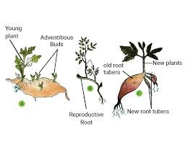
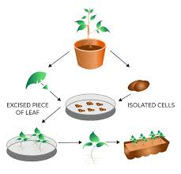
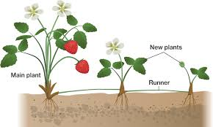
What type of asexual reproduction is shown?
Vegetative Reproduction – cells in plants that can grow into new identical plants

Slide 30
What happens during fragmentation?
Part of an organism breaks off. The fragment will form into a genetic copy of the original organism

Slide 31
What are disadvantages of asexual reproduction?
Lack of genetic diversity so if change in environment that is hostile all identical organisms adversely affected
Too many offspring in one area complete for resources

Slide 32
How does fruit help a plant increase likelihood that offspring will survive ?

Slide 33
Disperses seed enclosed in fruit to a new location as the animal who eats the fruit and will later excrete feces in a new location
The seed is then able to germinate away from parent with less competition for resources

Slide 34
What is the purpose of meiosis?
To produce gametes

Slide 35
What are the two types of gametes?
Sperm and eggs

Slide 36
Gametes are diploid. True or False?
False – haploid – only have one copy of each chromosome – only body cells are diploid

Slide 37
How do cells become diploid?
When sperm penetrates egg during fertilization the nuclei fuse and the cell now contains two copies of DNA making it diploid

Slide 38
What is a zygote?
When both male and female gametes combine the end result is called a zygote?

Slide 39
What makes a zygote an embryo?
When the zygote undergoes cell division to produce more cells

Slide 40
What is an advantage of internal fertilization?
Offspring protected from predators and environment
Nutrients and resources readily available
Cared for by parent

