Slide 1
Cancer

Slide 2
“About 2,075 young people in Canada between 15 and 29 years of age are diagnosed each year with cancer and about 326 deaths per year in that age group. The five-year survival for this age group is 85 per cent — a five per cent increase from 1992 to 1995.” - Canadian Cancer Society statistics reported by CBC on April 16th, 2009 -

Slide 3
What is it?

Slide 4
Checkpoints in the cell cycle usually stop division if: * The cell is lacking nutrients * DNA Replication did not occur or is not finished * The DNA is damaged

Slide 5
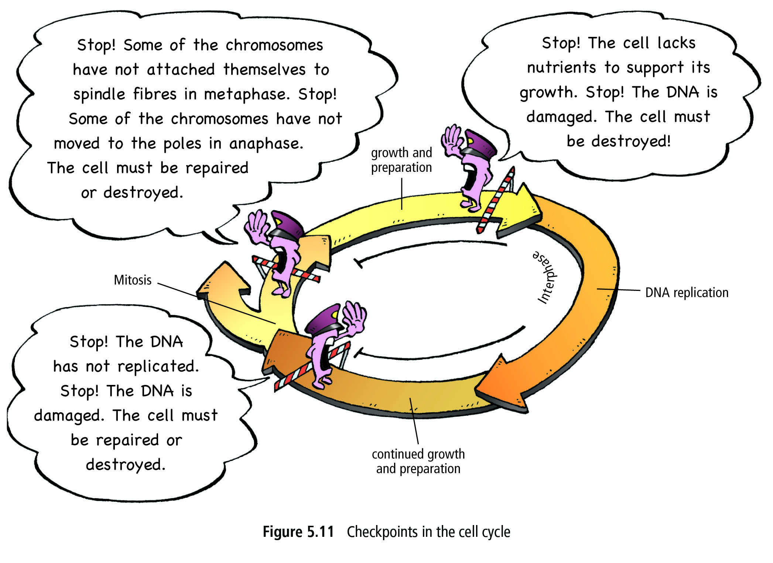

Slide 6
If mutation prevents checkpoint proteins from being produced, cells divide uncontrollably * Out-of-control cells keep dividing, forming a tumour * Healthy cells become cancer cells

Slide 7
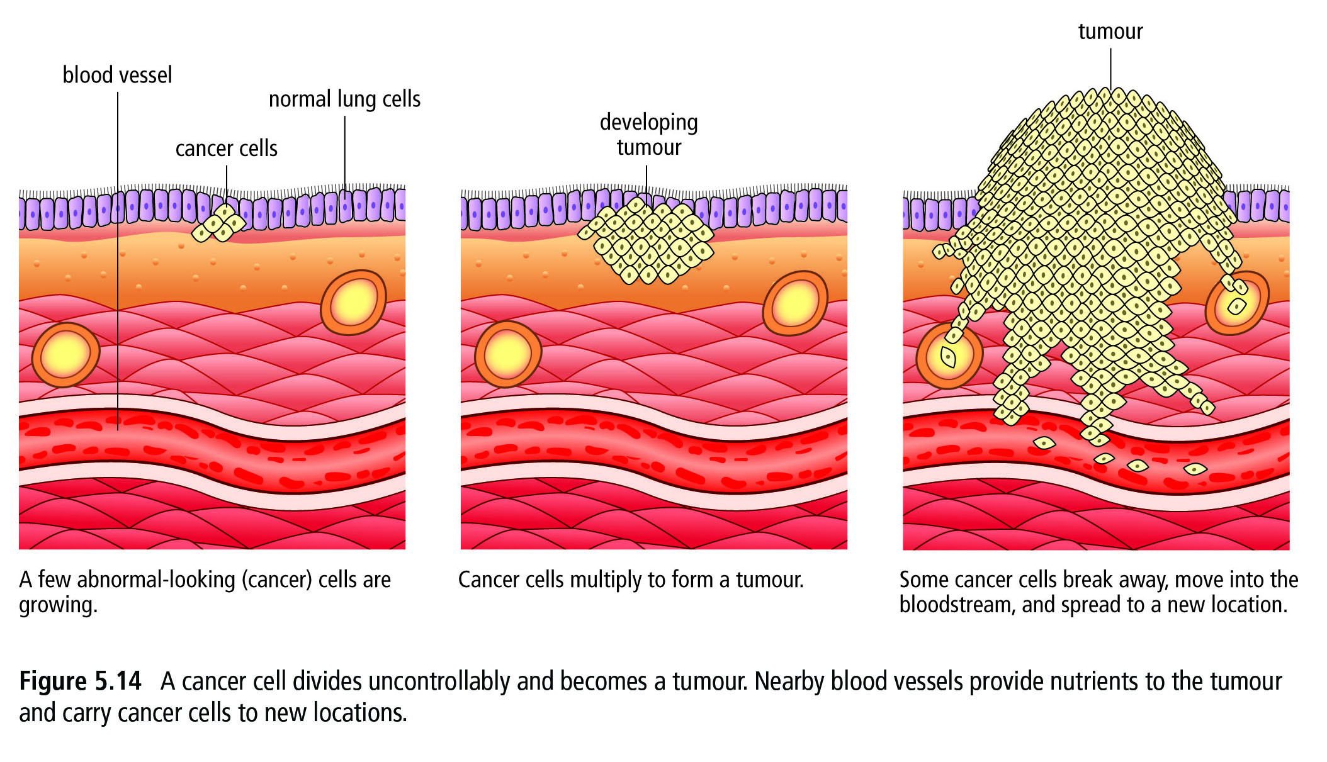

Slide 8
Cancer cells do not function normally. They just get in the way and block normal cells from functioning.

Slide 9
A tumour becomes “malignant” when cancer cells break off and flow into the blood stream – spreading through the body. This becomes difficult to treat.
What is cancer? [video]

Slide 10
Cancer Research [video]

Slide 11
HOMEWORK: Read p. 159 – 161

