Slide 1
CELL CYCLE
MODELLING ACTIVITY

Slide 2
STEPS
TAKE OUT CONTENTS OF ENVELOPE AND MAKE SURE ALL MATERIALS ARE PRESENT – REFER TO LIST ON FRONT OF ENVELOP
YOU WILL USE THESE MATERIALS TO MODEL THE DIFFERENT STAGES OF CELL CYCLE AND MITOSIS
USE THE MATERIALS AS DESCRIBED – I.E. LONG GREEN YARN IS THE CELL MEMBRANE, AND TWO COLOURED PIPECLEANERS ATTACHED BY BEAD REPRESENTS ONE DUPLICATED CHROMOSOME
REFER TO NOTES FOR DETAILS OF STAGES
WHEN ALL STAGES HAVE BEEN MODELLED AND THE TEACHER HAS ACCESSED YOUR GROUP RETURN ALL MATERIALS TO ENVELOPE COUNT EACH ITEM AND PUT PASTA, BEADS AND BEANS BACK IN ZIPLOC.

Slide 3
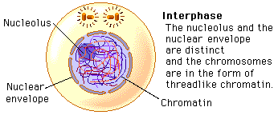
INTERPHASE

Slide 4
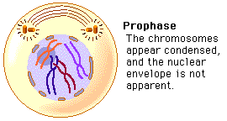
PROPHASE
Nucleolus disappears

Slide 5
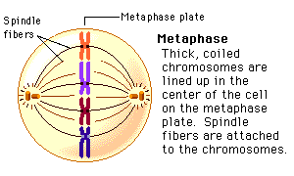
metaphase

Slide 6
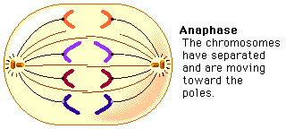
Anaphase

Slide 7
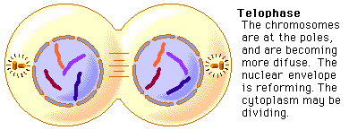
Telophase

Slide 8
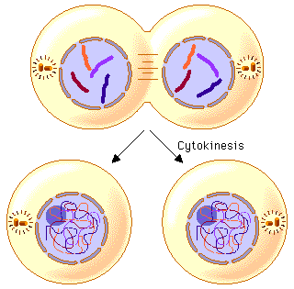
cytokinesis

Slide 9
Please put away modelling materials!
Put 2 beads, 4 beans and 21 pasta pieces back into ziploc bag
Count other modelling materials and place them in envelope.
If missing something tell the teacher so that it can be found or replaced
Place the sealed ziploc in the envelope

