Slide 1
Nutrient Cycles
What nutrients are essential for life?
CARBON NITROGEN PHOSPHORUS

Slide 2
Carbon cycle
Carbon is the most abundant element on earth, it moves through the earth’s spheres in many forms
Carbon dioxide (CO₂) gas moves from atmosphere and biosphere and back again through photosynthesis and cellular respiration
CO₂ also moves back to the atmosphere when organisms die and their bodies decompose
CO₂ continually leaves the atmosphere when it is dissolved into the hydrosphere where it then becomes available to aquatic organisms

Slide 4
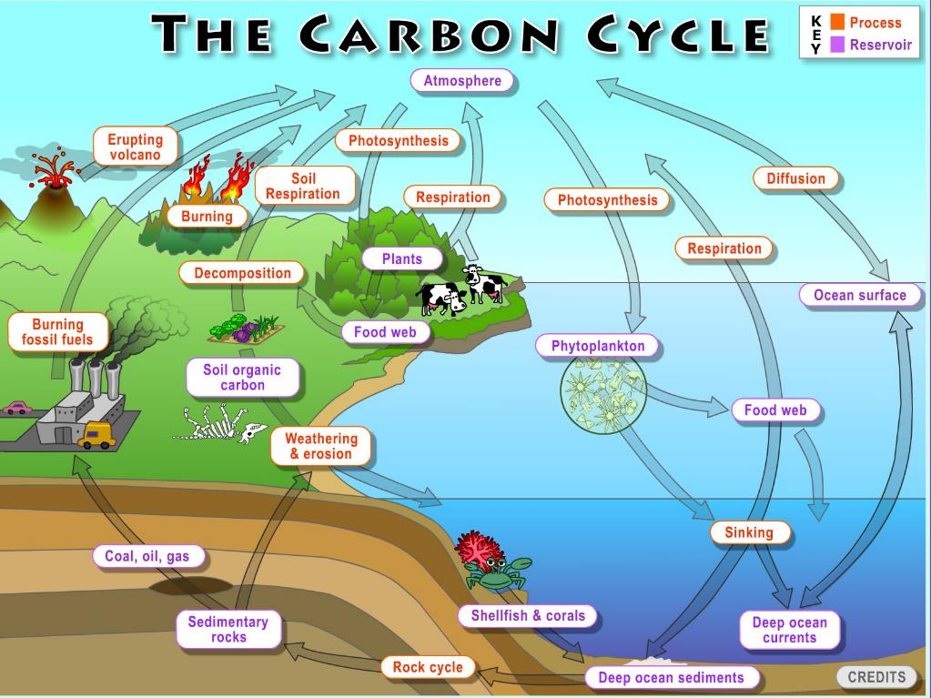

Slide 5
Stored Carbon
In woody tissues of long-living trees
Carbon dissolves in the oceans which act as a huge reservoir for carbon
In slowly decomposing organisms that become deeply buried in the ground
This is the carbon that becomes fossil fuels -coal, oil and natural gas

Slide 6
Human impact
Amount of CO₂ used in photosynthesis and given off by respiration is the same so CO₂ is balanced
However, when we burn trees, coal, oil, natural gas for fuel, the carbon stored in these sources is released into the air as CO₂ gas
This upsets the balance
We also have cut down many trees for houses, cities, agriculture, furniture and paper so there are fewer trees that can use the extra CO₂ for photosynthesis

Slide 7
Human impact
Extra CO₂ builds up in the air and helps trap heat in the atmosphere
CO₂ gas adds to global warming (an increase in the average temperature of the earth’s surface) and climate change (a long-term change in earth’s climate)
Climate change can be caused by natural factors and is accelerated by human activity

Slide 8
Greenhouse Affect
Various greenhouse gases in troposphere trap escaping infrared radiation from the sun (heat energy)
Such as CO₂, H₂0 (water vapour), CH₄, CFC’s, N₂0
This is a natural process
Human activities put more of these gases into atmosphere increasing the amount of heat absorbed in atmosphere

Slide 9
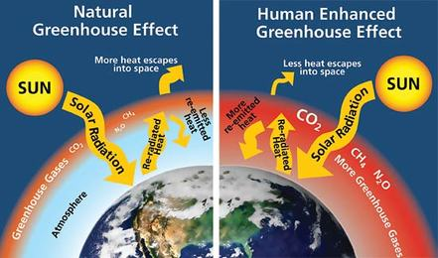

Slide 10
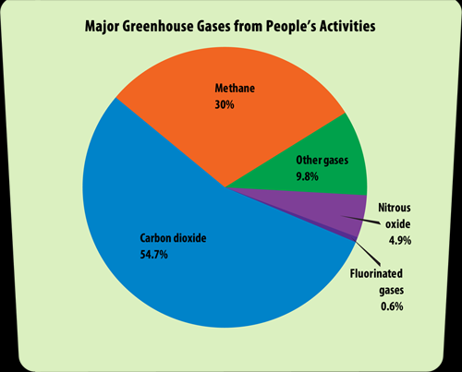

Slide 11
Human Activities influencing Green House Gases in Atmosphere

Slide 12
Effects of excess Carbon
Earth’s surface temperature has increased between 0.56ºC and 0.92ºC in the past 100 years
Small change but big deal because Earth’s climate is a system
So a change is one aspect (temperature) result in changes to other aspects such as precipitation levels, wind patterns, storm severity
list examples that follow!

Slide 13
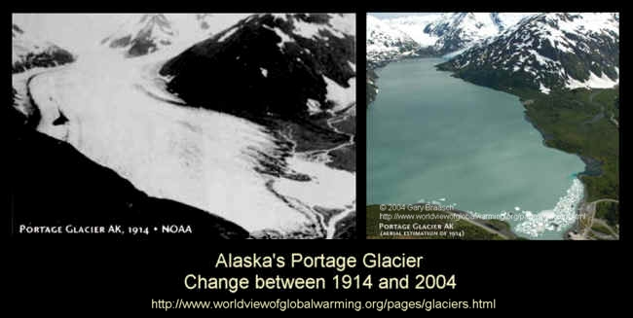
IMPACT OF CLIMATE CHANGE AND/OR GLOBAL WARMING

Slide 14
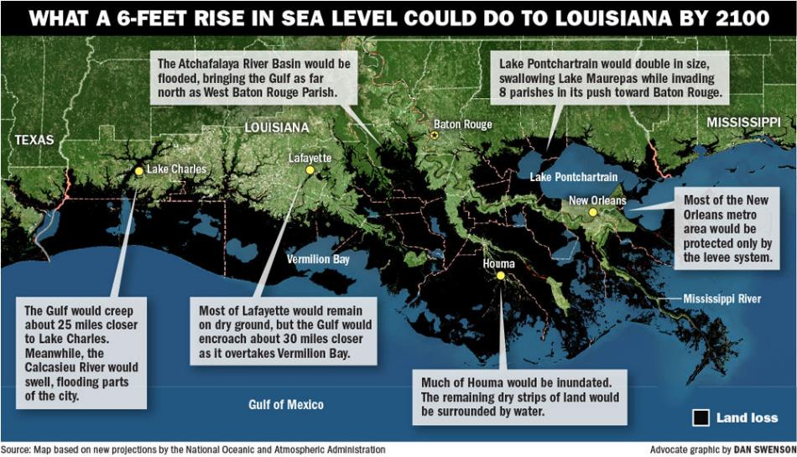

Slide 15
Severe Storms
Cat. 5 Hurricane
Tropical Storm
Tornado
Cyclone

Slide 16
Watch Video: Keeping up with Carbon
Task read additional notes Handout
Complete questions that follow
Use your notes/handout/internet

Slide 17
Nitrogen cycle
Nitrogen is used by organisms to make PROTEINS
It makes up 78% of the air but most living things can’t use nitrogen (N₂) gas from the air
Plants get nitrogen from the soil after it has been changed to forms that plants can use such as nitrates.
Special bacteria in the soil can change nitrogen into usable forms so plants can absorb the nutrients through their roots.

Slide 18
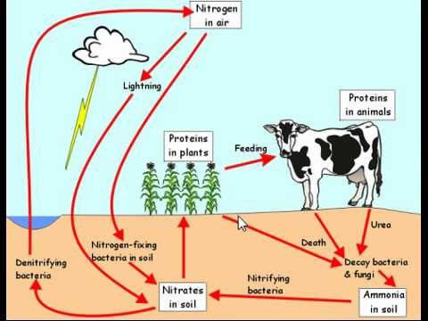

Slide 19
Phosphorus cycle
Phosphorus is used by organisms as they GROW AND DEVELOP - In DNA and ATP
When rocks are broken down due to WEATHERING and erosion, phosphorus is released into the soil and water
Plants ABSORB the phosphorus and animals obtain it when they eat the plants or other animals that eat the plants
Usable forms of phosphorus are PHOSPHATES
DECOMPOSERS return phosphorus to the soil and water as they break down dead organisms

Slide 20
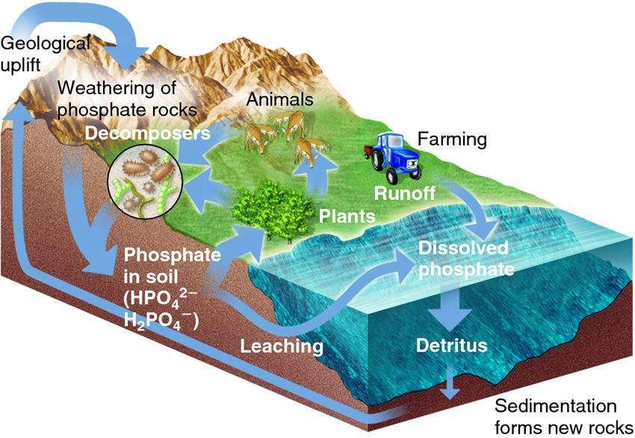
Phosphorus cycle

Slide 21
Human impact on Nitrogen and Phosphorus Cycles
We dramatically increase nitrogen in the atmosphere by burning FOSSIL FUELS These substances mix with water in clouds to produce ACID RAIN- HNO₃
Farmers and gardeners use FERTILIZERS (which contain nitrates and phosphates) to enhance the GROWTH of their plants but not all the nutrients in the fertilizers are used and some stays in the SOIL.
When the soil is watered or it rains, excess nutrient are carried by RUN-OFF to ponds, rivers, lakes, oceans which can cause an OVERGROWTH OF ALGAE (Eutrophication) and death of many aquatic organisms.

Slide 22
http://www.wheatleyriver.ca/wp-content/uploads/2011/02/Eutrphication.jpghttp://www.wheatleyriver.caw-content/uploads/2011/02/Eutrphication.jpg

Slide 23
Human impact
Phosphates are also found in CLEANING PRODUCTS SUCH AS LAUNDRY DETERGENT
Human WASTE contains high levels of phosphorus
MINING of phosphorus from deep underground rocks increases available phosphorus

