Slide 1
Nutrient Cycles
What nutrients are essential for life?

Slide 2
LIST NUTRIENTS ESSENTIAL TO LIFE ___________ ___________ _____________
THE CARBON CYCLE
Carbon is the most abundant element on earth, it moves through the earth’s spheres in many forms
Carbon dioxide (CO₂) gas moves from ______________ and ________________ and back again through photosynthesis and ___________________ respiration
CO₂ also moves back to the atmosphere when organisms _________and their ____________ decompose
CO₂ continually leaves the atmosphere when it is ___________________ into the hydrosphere where it then becomes available to aquatic organisms

Slide 4
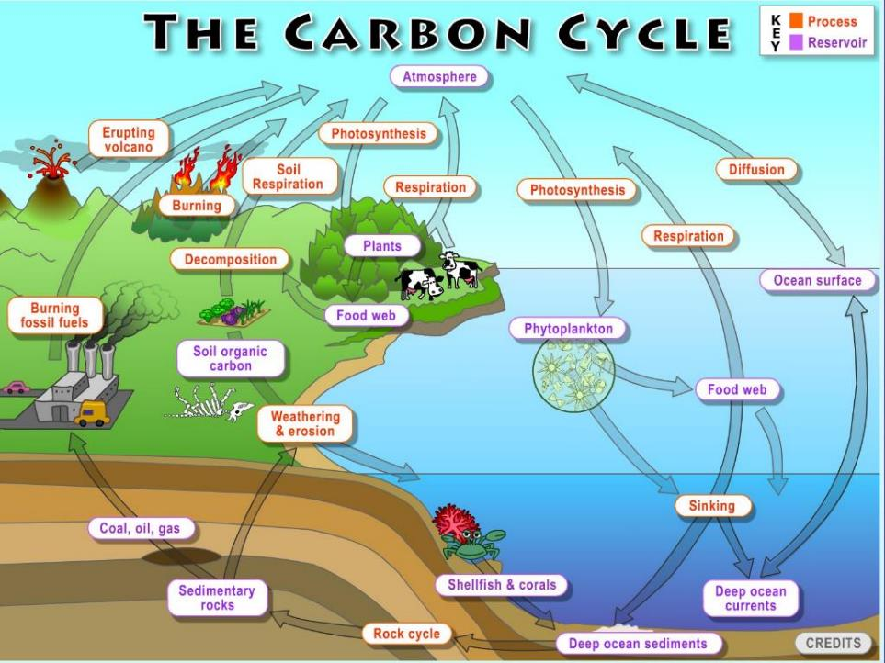

Slide 5
Stored Carbon
In _____________ tissues of long-living ______________
Carbon dissolves in the _____________ which act as a huge_________________for carbon
In slowly decomposing organisms that become deeply buried in the ____________________
This is the carbon that becomes ____________________ _____________________________

Slide 6
Human impact
Amount of CO₂ __________ in photosynthesis and ______________ by respiration is the same so CO₂ is balanced
However, when we ___________ trees, coal, oil, natural gas for fuel, the carbon stored in these sources is ______________ into the air as CO₂ gas
This upsets the balance
We also have cut down many trees for houses, cities, agriculture, furniture and paper so there are fewer trees that can use the extra CO₂ for photosynthesis

Slide 7
Human impact
Extra CO₂ builds up in the _______________ and helps trap ______________ in the atmosphere
CO₂ gas adds to ___________________ warming (an increase in the average temperature of the earth’s surface) and ________________ change (a long-term change in earth’s climate)
Climate change can be caused by natural factors and is accelerated ______________________________

Slide 8
Greenhouse Affect
Various greenhouse gases in troposphere trap escaping _________________radiation from the sun (heat energy)
Such as CO₂, H₂0 (____________), CH₄, CFC’s, N₂0
This is a ______________process
Human activities put ____________ of these gases into atmosphere _______________ the amount of heat absorbed in atmosphere

Slide 9
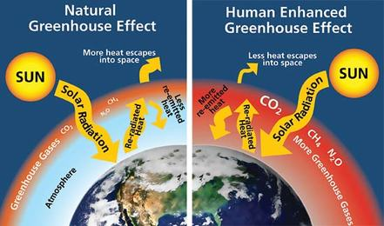

Slide 10
Human Activities influencing Green House Gases in Atmosphere

Slide 11
Effects of excess Carbon
Earth’s surface temperature has increased between 0.56ºC and 0.92ºC in the past __________ years
Small change but big deal because Earth’s climate is a system
So a change is one aspect (temperature) result in changes to other aspects such as precipitation levels, _________________ patterns, storm severity
List and briefly describe examples that follow:
1. 3.
2.

Slide 12
Nitrogen cycle
Nitrogen is used by organisms to make _______________
It makes up ________of the air but most living things can’t use nitrogen (N₂) gas from the air
Plants get nitrogen from the ____________after it has been changed to forms that plants can use such as _____________________.
Special ____________________ in the soil can change nitrogen into usable forms so plants can absorb the nutrients through their roots.

Slide 13
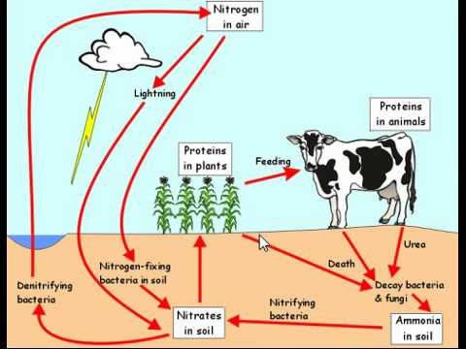

Slide 14
Phosphorus cycle
Phosphorus is used by organisms as they ___________ __________________________
When rocks are broken down due to ______________ and erosion, phosphorus is released into the soil and water
Plants _______________the phosphorus and animals obtain it when they eat the plants or other animals that eat the plants
Usable forms of phosphorus are ____________________
_____________________return phosphorus to the soil and water as they break down dead organisms

Slide 15
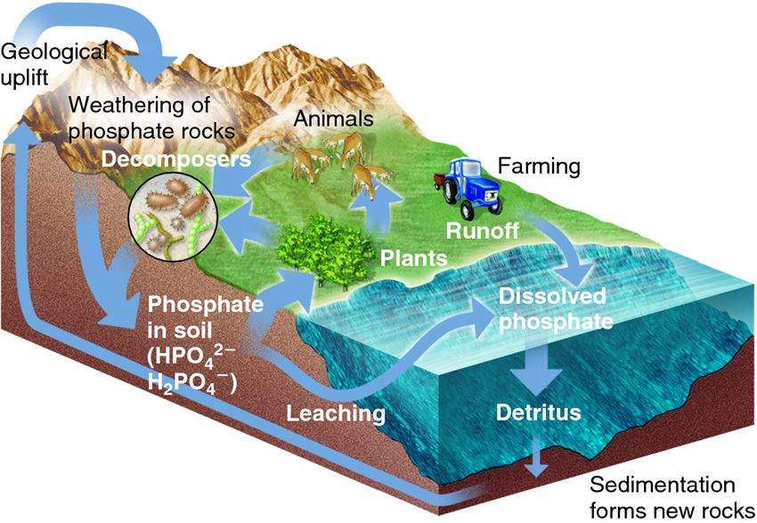
Phosphorus cycle

Slide 16
Human impact on Nitrogen and Phosphorus Cycles
We dramatically increase nitrogen in the atmosphere by burning _________________________ These substances mix with water in clouds to produce
__________________________________- HNO₃
Farmers and gardeners use __________________ (which contain nitrates and phosphates) to enhance the ____________________ of their plants but not all the nutrients in the fertilizers are used and some stays in the ________________
When the soil is watered or it rains, excess nutrient are carried by _________________________ to ponds, rivers, lakes, oceans which can cause an _____________________________ (Eutrophication) and death of many aquatic organisms.

Slide 17
Human impact
Phosphates are also found in ____________________ ________________________
Human _______________ contains high levels of phosphorus
______________ of phosphorus from deep underground rocks increases available phosphorus

Slide 18
Nutrient Cycles & Human Impact Poster
Complete Assignment: Nutrient Cycles and Human Impact / 30 marks
Create a labelled poster that shows:
- The important ways humans impact the Carbon, Nitrogen and Phosphorus cycles /10
Plants can only use the essential nutrients in specific forms! Show which chemicals are used by plants and from where (ground or air) the plants obtain these nutrients ? /5
Show on poster where each nutrient is predominately stored or found! Carbon has many stores. Phosphorus does not! /5
Note phosphorus is not found in the atmosphere! Nitrogen is mainly found in the _____?
For the carbon cycle only show the key processes that cycle carbon between the spheres: ie. Decomposition, photosynthesis, cellular respiration and dissolving of CO₂ into bodies of water etc. /5
Fine line print! Label all diagrams… use arrows to show movement of carbon between all four spheres! Neatly colour diagrams /5

