Slide 1
Circuits: Short, Series and Parallel

Slide 2
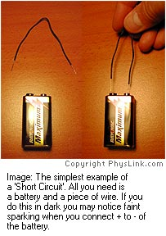
Short Circuit
A complete circuit without a resistor
Electricity is lazy take the path of least resistance
Caused by two conducting wires touching or a paper clip might bypass a load
Results in excessive current flow through the ‘short’
Drains battery quickly
Can destroy power source,
create heat, sparking and/or a fire
DEMO!!!

Slide 3
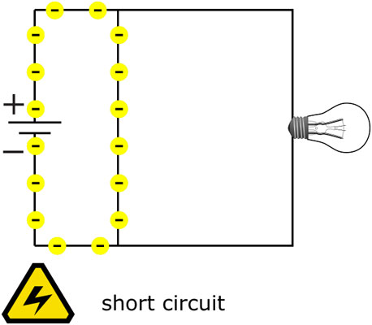
Short Circuit
Schematic Diagram

Slide 4
Series Circuits
Electrons have only one path to follow through circuit

Slide 5
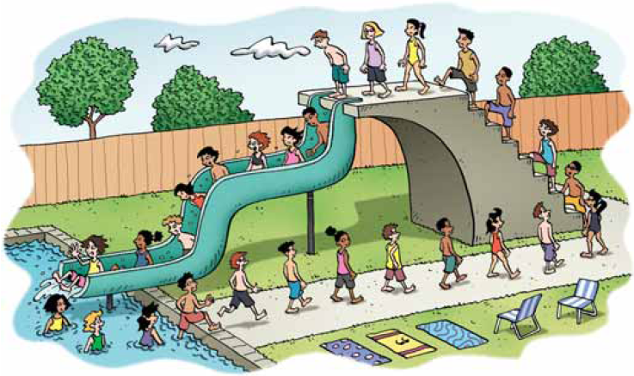
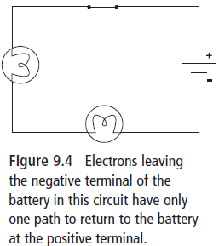
Series: one pathway

Slide 6
Voltage in Series
Voltage is the difference in potential energy between two points
If electrons gain 12 V from the battery, they will lose all 12 V as they travel from the –ve to the +ve terminal of the battery through the circuit
Staircase analogy –12 steps up-gain potential energy- 12 steps down lose same energy

Slide 7
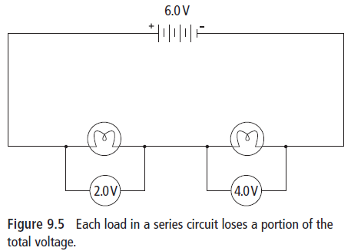
Voltage in Series
Along the circuit, electrical potential energy is converted to other types of energy as it passes through resistors, and loads
In light bulbs this energy is converted to heat and light

Slide 8
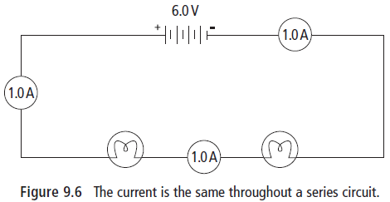
Current in Series
Since electrons repel each other, they remain evenly spaced out
Within the same pathway, current remains the same

Slide 9
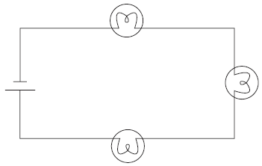
Resistance in Series
There is only one pathway for current
Adding more resistance to the same pathway increases the total resistance and decreases the current in that pathway
E.g. Adding a dry and sticky portion of a slide after the last one decreases the rate of flow for all the people going down the slide
Adding more bulbs increases total resistance resulting in total current decreasing.

Slide 10
Parallel Circuits
Give electrons more than one path to follow through circuit

Slide 11
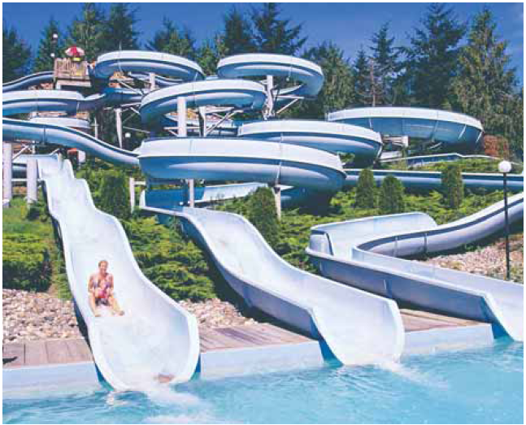
Parallel: more than one pathway

Slide 12
Voltage in Parallel
Within each pathway, the total voltage gained by the battery is lost
E.g. There could be many water slides (pathways) people can go down, but every person will go down the same height and end up in the same pool (positive terminal)

Slide 13
Current Parallel
The total current will split up at a junction point and rejoin where the paths meet
More current will flow through paths with less resistance
E.g. At the top of a waterslide (junction) an attendant makes people go to the next available slide – the slides with the least resistance will have more people going down it every second

Slide 14
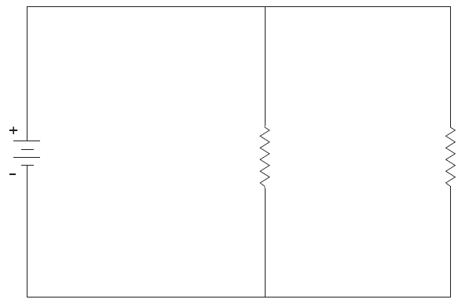
Resistance in Parallel
Any time you create another pathway, you decrease the total resistance in the circuit
Even if you are adding resistors, adding them in parallel will decrease the total resistance
E.g. Adding another water slide at the water park will increase the flow of people coming down from the top of the slides

Slide 15
DO THIS!
Check your understanding questions pg. 319 (text) –questions listed in notes!
Circuit Diagrams- Current and Voltage worksheet

