Slide 1
Reproduction

Slide 2
Asexual Reproduction
Sexual Reproduction
Requires two parents
Produces offspring different from the parents.
Requires more time and energy to produce offspring
Results in lots of variation within a species
Meiosis is used to produce specialized sex cells called gametes: sperm (from males) and eggs (from females), which combine to produce a new individual.
Requires one parent
Produces offspring identical to the parent.
Can produce many offspring very quickly
Results in limited variation within a species
Mitosis is one form of asexual reproduction and results in offspring that are identical to parent.

Slide 3
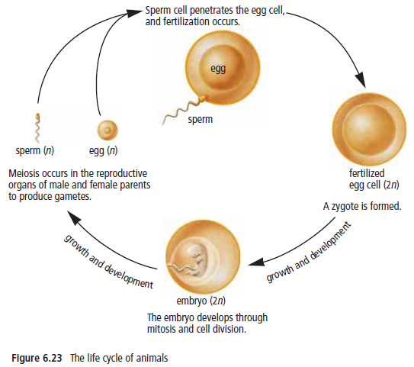
How SEXUAL REPRODUCTION Works: Two Parents → DNA from each Parent → Genetically unique Offspring

Slide 4
Process of Fertilization
A single sperm penetrates the outer covering of the ovum (egg)
Nuclei of sperm and ovum fuse = single fertilized cell is formed
The fertilized cell is called a zygote.
The zygote begins to divide by mitosis producing more cells.
Once a zygote becomes two cells, it is called an embroyo. The embryo increases in size by further cell division (mitosis) and eventually develops specialized cells which make up various body structures in an organism.

Slide 5
In Sexual Reproduction
It is essential that:
Gametes must arrive in the same place at the same time so that genetic information can be combined.
Internal Fertilization vs External Fertilization
Success after fertilization requires:
enough nutrients and moisture and appropriate temperature
protection from predators
-Sperm meet egg inside female body -Embryo/offspring develop protected by parents -Few offspring | -Sperm meet egg outside -Lots of offspring produced quickly -Exposed to outside world -Many offspring don’t survive

Slide 6
Internal vs External
Bald Eagles Mating
Sea Urchins release gametes into water

Slide 7
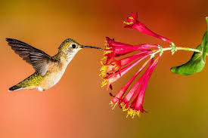
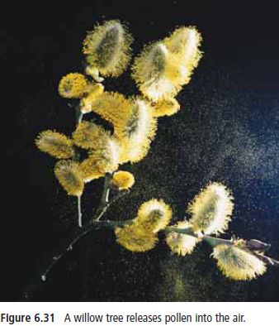
Pollen /Seed Transport Purpose: Increase Genetic Diversity and Survival of Offspring
Move pollen or seeds away from parent (as far as possible)
Genes spread around rather than remaining near parent
Pollen (containing sperm) released and carried by wind to female parts by insects and some birds by pollination.

Slide 8
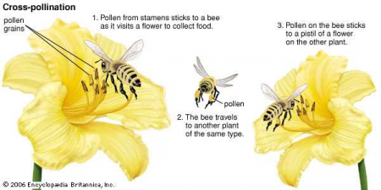

Slide 9
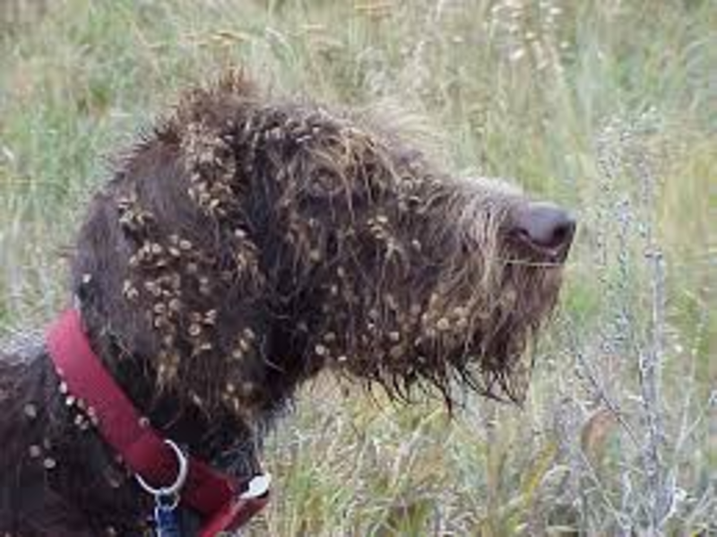
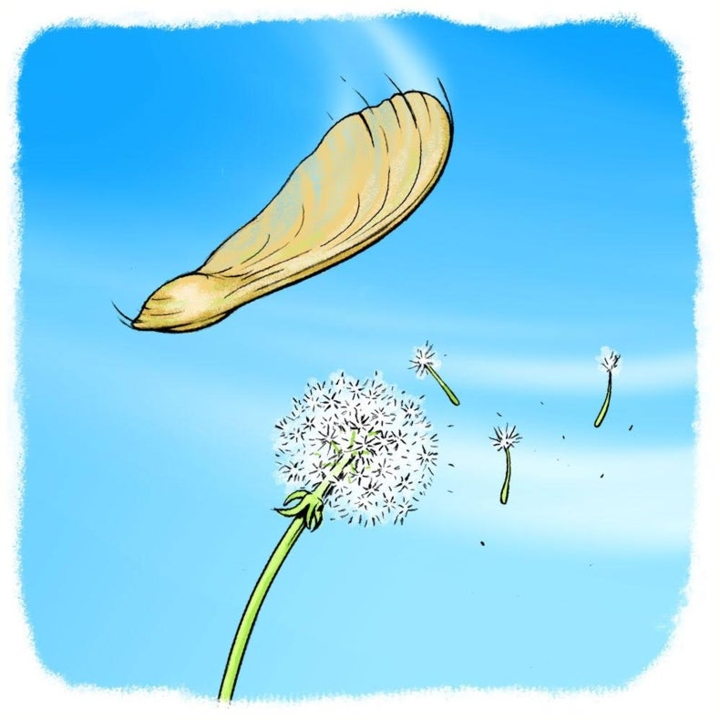
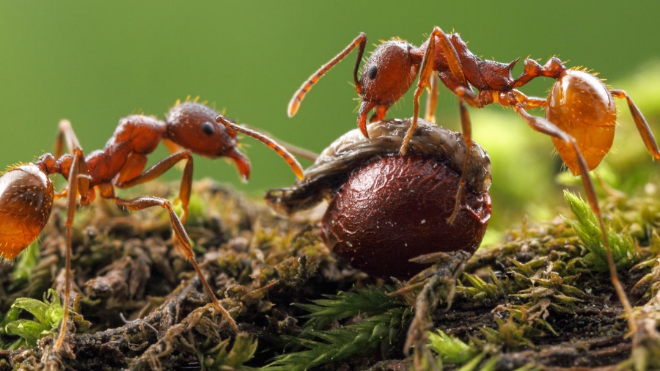
Seed Dispersal
Hitchhiker Seeds - Burrs
Wind
Eat my treat move the seed!

Slide 10
Purpose of Fruit
Fruit contain seeds which hold the zygote (fertilized eggs)
Eaten by animals and dispersed in feces to form new plants.
New plants grow away from parent plants so less competition for food and other resources which increases survival of offspring.
Fruit also protect seeds from environment.

Slide 11
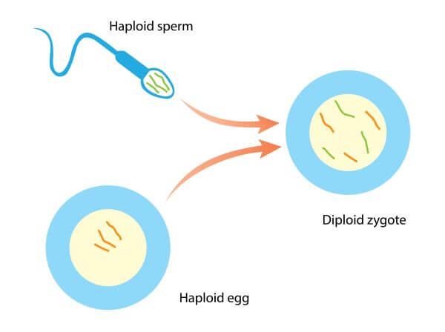
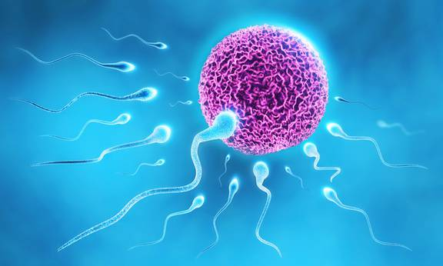
HAPLOID VS DIPLOID CELLS & MEIOSIS

Slide 12
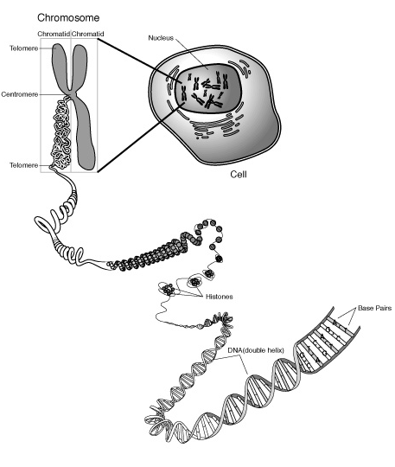
Chromosomes are DNA!
DNAn Body Cells and Mitosis
Chromosomes contain genetic information
Mitosis ensures all cells in the body (except specialized sex cells)
have the same DNA and the same number and kind of Chromosomes
Mitosis occurs in somatic or body cells
Ex: blood, muscle, heart, liver cells

Slide 13
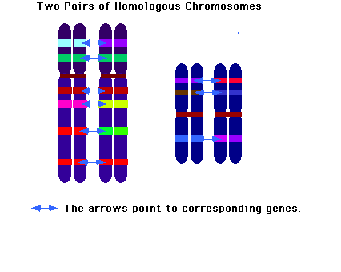
Diploid Cells
Every organism has its own unique number of chromosomes. Humans have 46.
This is called its diploid number or the total number of chromosomes in each body cell.
Diploid means “2 copies ” and is written as “2n”.
Body cells of adult organisms have 2 sets of (matching) chromosomes – called Homologous chromosomes 1 set from female parent gamete and 1 set from male parent gamete

Slide 14
Haploid Cells
Gametes are specialized sex cells produced during meiosis. A similar process to mitosis which involves two cell divisions.
Gametes are haploid cells (n) because each sperm or egg cell only has one copy of each chromosome.

Slide 15
Meiosis - Formation of Gametes Two Parts: Meiosis I- PMAT I and Meiosis II-PMAT II Prophase I, Metaphase I, Anaphase I, Telophase I Interkinesis Prophase II, Metaphase II, Anaphase II, Telophase II and Cytokinesis

Slide 16
MEIOSIS

Slide 17
Meiosis - A process in which the number of chromosomes in the original cell is reduced by HALF through the separation of homologous chromosome
Meiosis occurs in sex organs only
Males (XY) – sex organs are the testes in humans
Females (XX) – sex organs are the ovaries in humans
Meiosis also occurs in the sex organs of other animals, plants, fungi, etc…
When does meiosis occur in humans?
Males beginning at puberty
Females before birth – all eggs are produced before birth and at puberty eggs mature

Slide 19
Sex Cells
Meiosis produces sex cells called gametes – cells with ½ the number of chromosomes as the original parent cell
Males – meiosis produces 4 sperm cells
Females – meiosis produces 1 (viable) egg
-The other 3 cells are called polar bodies – they give up their cytoplasm to nourish the 1 healthy egg.

Slide 21
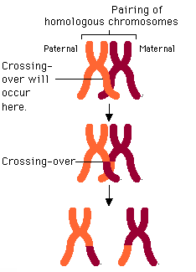
Unique Events in Meiosis
Homologous chromosomes pair up before 1st cell division
Homologous chromosomes:
-look alike
-code for same traits
-receive one from each parent
During 1st division, homologous chromosomes exchange genes during process called “crossing over”

Slide 22
These homologous chromosomes separate during 2nd division of meiosis – so chromosomes in gametes are different from each other due to crossing over
Crossing over increases genetic variation and is the reason why siblings look different

Slide 23
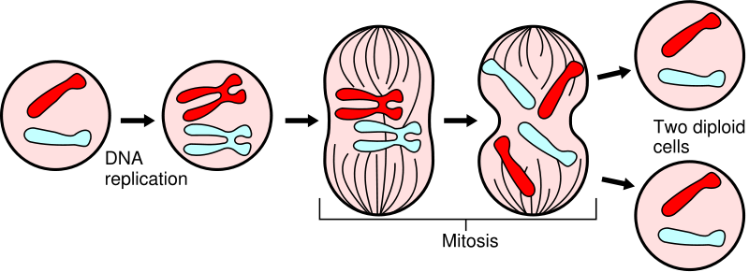
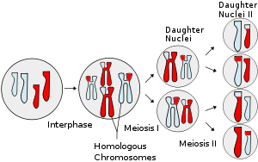
Mitosis vs Meiosis
Mitosis
Mitosis
No crossing over – daughter cells are identical to parent cells
Meiosis
Crossing over occurs –causes genetic variation
(Daughter cells are NOT identical to parent cell)

Slide 24
To Do!
Continuation of life video
Comparison between mitosis and meiosis
Exit Reflection questions
Snurfle Meiosis Activity
www.biomanbio.com

