Slide 1
The Periodic Table of Elements

Slide 2
Imagine going to the library and finding all the books in big messy piles

Slide 3
It could take a very long time to find the book you wanted.
Of course, in most libraries, books are arranged in an orderly way.
It’s clear that grouping books in an organized way is very useful.

Slide 4
The same is true of chemical elements.
For many years, scientists looked for a good way to organize them.
This became increasingly important as more and more elements were discovered.
An orderly arrangement of elements, like the books in a library, is also very useful.

Slide 5
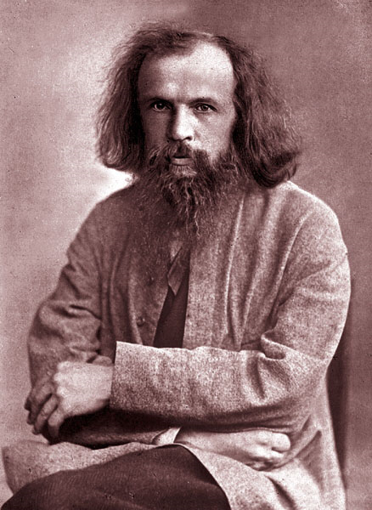
Responsible for the creation of today’s periodic table of elements
Dmitri Mendeleev

Slide 6
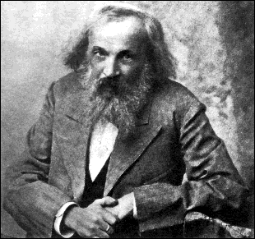
Origin of the Periodic table of Elements
In 1867, Dimitri Mendeleev found patterns in the elements and organized them into a table
Organized elements according to:
atomic weight
grouped elements with similar properties into families
The resulting table had holes for elements not yet discovered

Slide 7
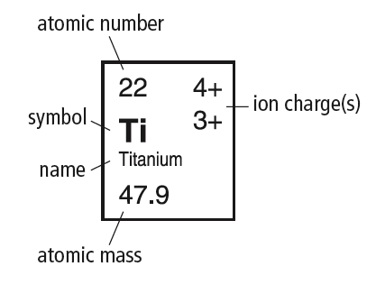
How is the periodic Table Organized?
1) By Element
Atomic Mass - mass of the average atom of an element
Atomic Number – is the number of protons in each atom of the element
Ion Charge - electric charge that forms when an atom gains or loses electrons
Elements are listed in squares containing the element symbol, name, atomic number, ion charge (s), atomic mass.

Slide 8
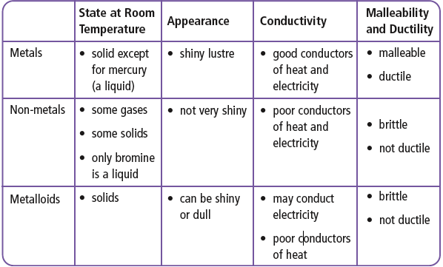
2) By Class
Metals, Non-metals, and Metalloids (Semi-metals).

Slide 9
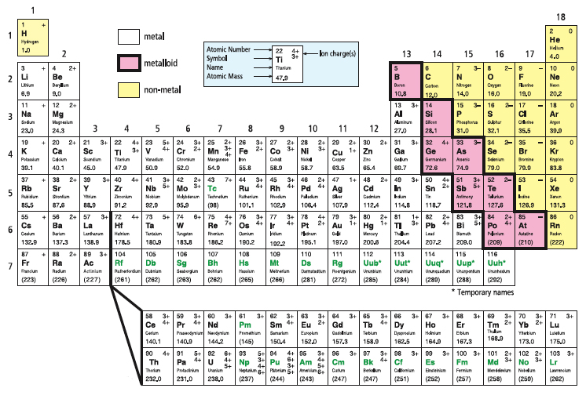
Where in the Table?

Slide 10
Complete #1-4- on the blank periodic table.

Slide 11
3) By Rows
Each horizontal row is called a period.
As you move across a period (row) each element has 1 more proton than the element before which means the atomic number increases by 1.
The atomic mass also increases from left to right

Slide 12
Do #5 - 7 . Focusing on Periods in the table

Slide 13
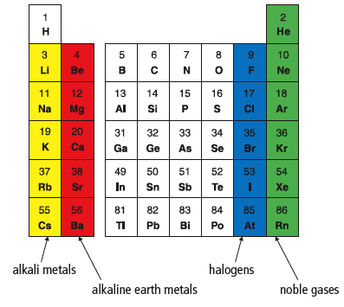
4) By Groups / Families
Vertical columns – are called groups or families
Elements in the same column have similar properties ex. Group 18 = unreactive gases
Alkali metals - group 1, highly reactive
Alkaline earth metals - group 2, burn in air if heated
Halogens - group 17, highly reactive non-metals
Noble gases - group 18, stable and unreactive non-metals

Slide 14
Complete #8-15 – On groups, charges, diatomic elements.

Slide 15
What are some repeating patterns that can be observed when looking at the periodic table?
1) Atom size
2) Reactivity

Slide 16
Atom size
Atom size increases as we move down the groups and from right to left on the periodic table.
The greater the # of energy shells the larger the atom
The greater the mass of the nucleus in the same row the smaller the atom

Slide 18
Reactivity
Metals increase reactivity right to left and down each column
Non-metals increase reactivity left to right and up each column
Reactivity depends on how easily the atom gains or looses electrons.
Metals want to donate electrons to form a full outer shell and non-metals want to take electrons to form a full outer shell.

Slide 20
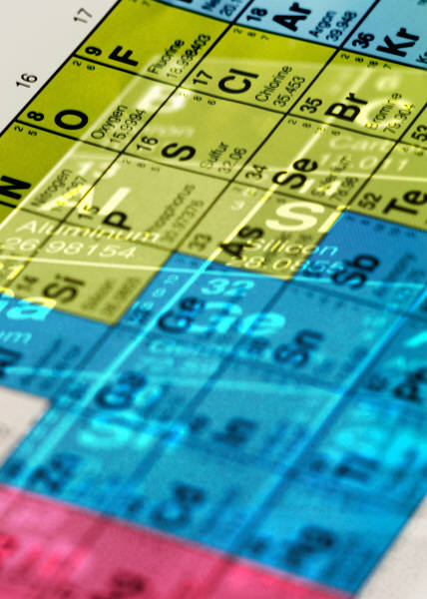
Do THIS!
Finish descriptions and required activities on the blank periodic table
Use the periodic table, notes and the internet to complete the questions on using the periodic table. This is for marks!

