Slide 1
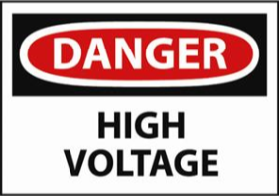
Voltage, Batteries and Cells and Resistance
Notes:
Click on button for story on backyard Tesla coil (YouTube)
Nikola Tesla dreamed of creating a way to supply power to the world without stringing wires across the globe. The inventor came close to accomplishing this when his "mad scientist" experiments with electricity led to his creation of the Tesla coil.
The first system that could wirelessly transmit electricity, the Tesla coil was a truly revolutionary invention.

Slide 2
Learning Goal: Elec 5- I can describe the relationship between current, voltage and resistance in circuits and use Ohm’s law to solve problems.
Current and Voltage

Slide 3
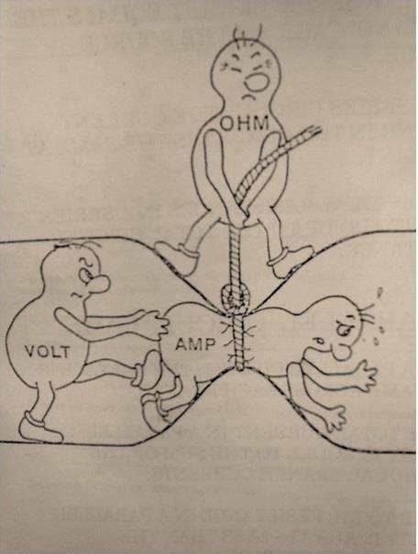
Voltage (V)
The electrical force that pushes electrons in a conducting material through a circuit
This push is called voltage or potential difference
Measured in volts (V) with a voltmeter
Analogy: voltage is like the pressure that pushes water through a hose

Slide 4
Voltage is often referred to as Potential Difference
Defined as the difference in potential energy, per unit charge, between two points in a circuit
Video: Voltage Explained - What is Voltage? Basic electricity potential difference - YouTube

Slide 5
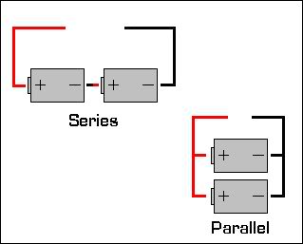
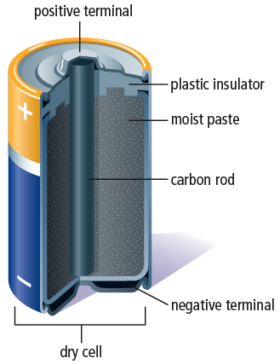
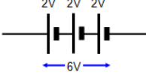
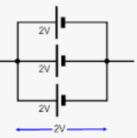
Batteries
Battery: one or more electrochemical cells connected together in series or parallel
Diagram Cells in the Circuit
An electrochemical cell converts chemical energy into electrical energy

Slide 6
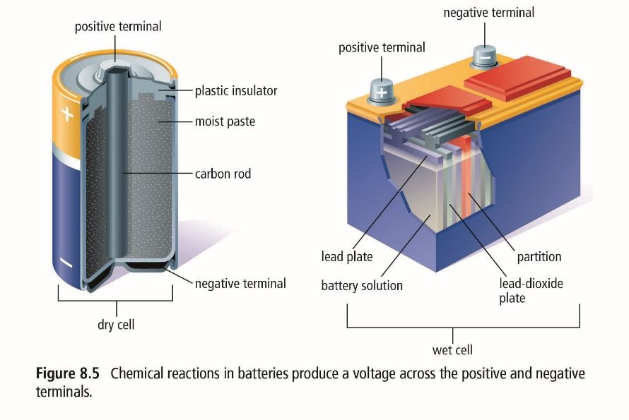
Producing Voltage
An electrochemical cell works by producing a potential energy difference between the +ve and –ve terminals.
2 types of batteries can produce voltage
Dry cells (eg. in flashlights) and wet cells (eg. car batteries)

Slide 7
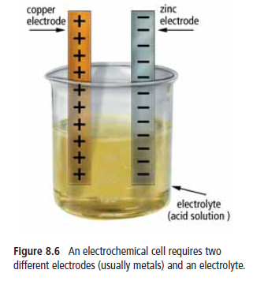
Battery terminals -Electrodes (usually metals) sit in a substance (paste or fluid) called electrolyte that conducts electricity.
LEMON LAB OR DEMO!
Notes:
Electrolyte pulls atoms off zinc which leave electrons behind on the zinc electrode – allows negative charge to build up
At same time chemical reactions with copper electrode pull electrons off the copper electrode- allows build up of positive charge
Electrodes become oppositely charged which results in a potential difference (voltage) between the two electrodes.

Slide 8
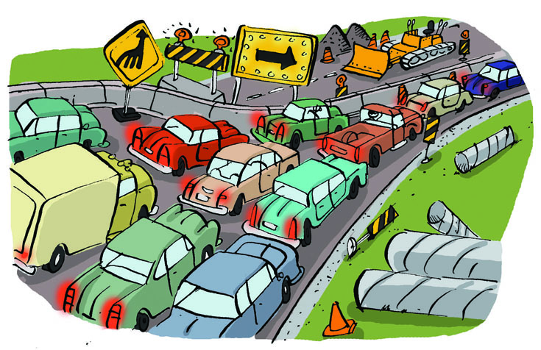
Resistance (R) in a Circuit:
This is the opposite of electron flow.
Created by any device that slows the passage of the electrons
Such as: wires, resistors, light bulbs, stoves, heaters (any load)
The current slows down because the electrons are interacting with the atoms in the device
Analogies:
-friction
-rocks in a stream, or a kink in the hose
-lanes of traffic merge to one

Slide 9
The amount of resistance depends on:
Type of material the device is made of
e.g. Copper, iron, silver
The path length: path = resistance
Good conductors have very little resistance
e.g. copper and silver
Good resistors slow the current or stop it completely. i.e. iron
e.g. Light bulb –slows current flow allowing electrical energy to change to light and heat energy
Measured in Ohms (Ω) by an ohmmeter

Slide 10
Respond to the following questions relating current, voltage and resistance
1. What is the definition of electric current and what unit is current measured in?
Electric current amount of charge (electrons) passing a given point every second.
Amperes (A)-the ampere is a measure of the amount of electric charge passing a point in an electric circuit per unit time with 6.241 × 10¹⁸ electrons, or one coulomb per second = one ampere.
2. What is the difference between a closed and an open circuit?
a closed circuit allows electrons to flow as all parts are connected and the switch is closed. In an open circuit the electrons do not flow because the switch is open. Current will not flow.
3. Use the charge of electrons to explain why electrons flow from negative to positive.
Electrons are negatively charged, so they repel and push each other from the –ve terminal to the +ve terminal

Slide 11
Alternating Current vs Direct Current The ongoing Debate!
https://www.youtube.com/watch?v=g17f9J1-r-k
Online science AC vs DC
http://www.pbs.org/wgbh/americanexperience/features/general-article/light-acdc/
https://learn.sparkfun.com/tutorials/alternating-current-ac-vs-direct-current-dc
http://www.cleanlineenergy.com/technology/hvdc/how

Slide 12
4. What type of devices use direct current? What is a disadvantage of using direct current?
DC is found in almost all electronics like lap tops and phones or in control circuitry of washing machines. You need to transform AC to DC if you wish to plug in most electronics into a wall .
5. What is an advantage of using alternating current? Where is it used?
AC is easier to transform between voltage levels, which makes high-voltage transmission more feasible. Transformers can easily transform higher voltages to lower voltage so that less voltage enters our homes.
Electricity from power plants is AC. This form of current is what we plug into from our homes
6. How is pressure in a water hose like voltage in a circuit?
The greater the pressure in a hose the faster the water flows. In a circuit, the higher the voltage from the source the greater the push on the electrons, the greater the current flow in the circuit.

Slide 13
7. Describe the role of a battery in an electric circuit?
The cell or battery is the source that provides the energy to push electrons through the wires and loads. The amount of push is what determines a cells potential difference, otherwise known as voltage.
Why do some devices have bigger batteries but still show same voltage?
Bigger batteries have more charge so can create more push.
8. What is resistance in a circuit?
Resistance is how hard it is for an electric current to flow through a material.

Slide 14
9. What factors influence the amount of resistance in a circuit?
Type of material – good conductors low resistance – insulators high resistance
Path length
10. How is resistance in a circuit like traffic moving into the tunnel on route to Vancouver during rush hour?
During rush hour three lanes merge into one to enter the tunnel. This happens in a circuit when current flows from a larger wire into a smaller wire like from the circuit wire into the filament in a light bulb.

Slide 15
What is the difference between direct current and alternating current give one advantage and disadvantage of each type of current?
Direct current the electric charge (current) only flows in one direction. Electric charge in alternating current (AC), on the other hand, changes direction periodically. AC is easier to transform between voltage levels, which makes high-voltage transmission more feasible. DC, on the other hand, is found in almost all electronics. You should know that the two do not mix very well, and you will need to transform AC to DC if you wish to plug in most electronics into a wall . High voltage DC lines experience less loss than equivalent AC lines over extremely long distances. Additionally, HVDC allows different AC systems (e.g. 50 Hz and 60 Hz) to be connected. Despite its advantages, HVDC systems are more costly and less reliable than the common AC systems.

