Slide 1
Asexual
Reproduction
Bio 3 – I can compare sexual and asexual reproduction.
Requires only one parent to reproduce!

Slide 2
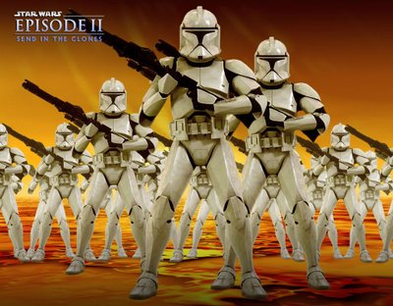
All offspring are clones – copies of each other and genetically identical to the parent

Slide 3
Do This!
With the person beside you, make a 2 column list of the “Pros” and “Cons” of asexual reproduction [5 min].

Slide 4
Advantages
No mate needed
Less effort (mating rituals not needed)
Less energy spent on reproduction
100% of DNA passed on to offspring
Large numbers of offspring can be produced quickly

Slide 5
Disadvantages
No variation in offspring
  If all offspring are genetic clones of their parents then any change in the environment that is harmful to the parent will also be harmful to the offspring
Eg. The effect of an antibiotic on bacteria
Too many offspring produced close together must compete for food and space
Notes:
Black moths would be less likely

Slide 6
What type of cells reproduce asexually?
  Somatic cells in the body such as skin, hair or muscle cells
  Plant cells so can plant can grow
What type of organisms reproduce asexually?
  Many unicellular organisms such as bacteria, amoeba and yeast
  Some plants
  Fungi
  Hydra

Slide 7
Types of Asexual Reproduction

Slide 8
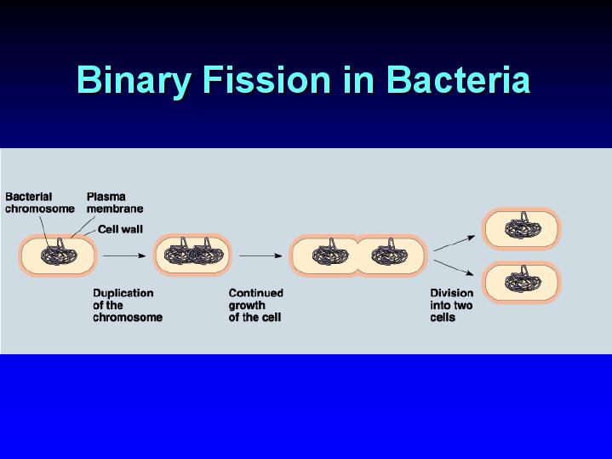
Binary Fission
Replication of DNA
Mitosis may occur
Cell divides into two parts
Eg. Amoeba, some bacteria (streptococcus), dinoflagellates (algae that cause red tide)

Slide 9
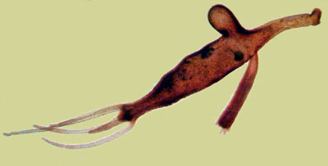
Budding
Occurs in some simple multicellular organisms
Areas of organism undergo mitosis (repeated cell division)
A bud develops that may or may not detach and move somewhere else
The bud can develop into an identical organism
Eg. Sponges
Eg. Yeast
Eg. Hydra
A budding hydra
Notes:
-simple organisms with only a few different types of cells- areas of individual may undergo repeated mitosis and cell division and can develop into an identical organism

Slide 10
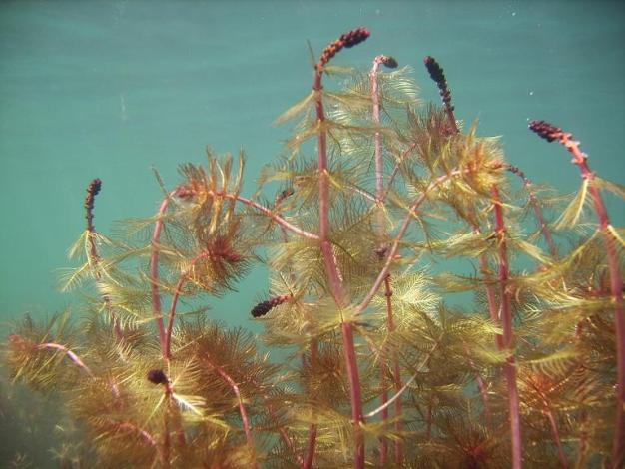
Fragmentation
Organism breaks apart
Each piece becomes a clone of the parent
Eg. Sea stars (starfish)
Eg. Eurasian milfoil (plant)
Eurasian Milfoil

Slide 11
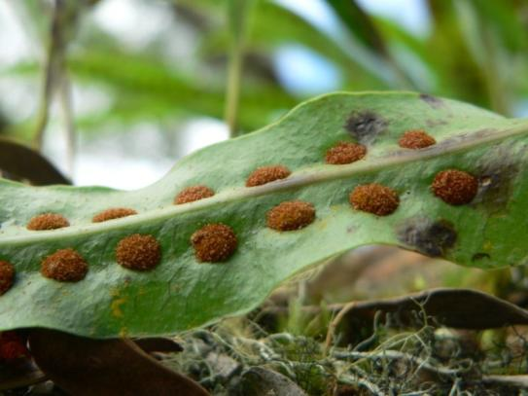
Spore Formation
Spores –single cells that can grow into a new individual by mitosis
Move with wind or water and will grow where it lands if conditions are right
Can develop tough outer coating to survive for years in harsh conditions
Eg. Bacteria
Eg. Bread mould
Eg. Mosses and ferns
Fern spores

Slide 12
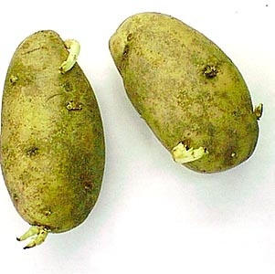
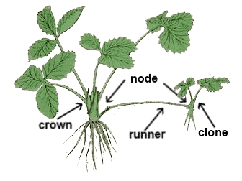
Vegetative Reproduction
Special cells in plant stems and roots divide rapidly to form structures that will become identical plants
Eg. Tulip
Eg. Potato
Eg. Strawberries
Potato with eyes

Slide 13
Vegetative
Reproduction and Agriculture

Slide 14
Cutting
Cutting – growing roots from parts of plants by using hormones and growth medias

Slide 15
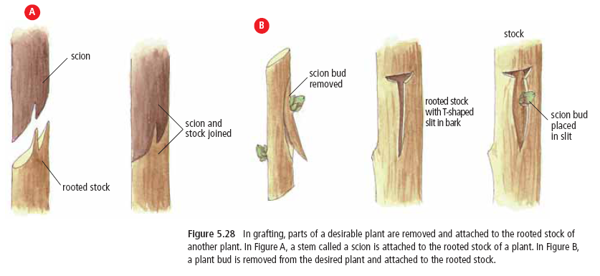
Grafting
Grafting – attaching one plant to another
Notes:
-apple yield is improved with grafting as good roots can be used to grow fruit in a couple of years vs 5-10 from seed and yield can be increased by choosing plant parts to graft from trees that produce a high yield of fruit

Slide 16
ASEXUAL ROLE PLAY
GET IN A GROUP OF FIVE
YOU WILL BE RANDOMLY ASSIGNED A TYPE OF ASEXUAL REPRODUCTION TO ROLE PLAY
YOU HAVE FIVE MINUTES TO THINK OF A WAY TO ACT OUT YOUR TYPE OF REPRODUCTION
THEN IT IS UP TO THE CLASS TO GUESS THE TYPE

Slide 17
Human-assisted
Cloning

Slide 18
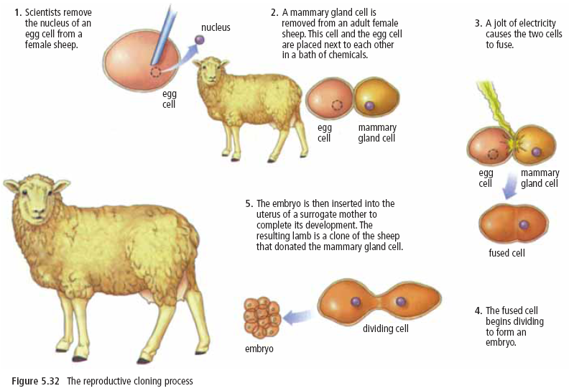
Reproductive Cloning
- to produce a genetic duplicate of an existing organism with desirable traits
Notes:
-cells become specialized as the embryo develops---so cannot turn any cell into a whole individual but can take the DNA from a skin cell and place it into an egg cell with the nucleus removed. This cell has the ability to develop into a new organism----dolly lived six years and died of lung disease… she did appear to age faster than normal sheep---clones often do not survive and have higher rates of cancer and infection from disease

Slide 19
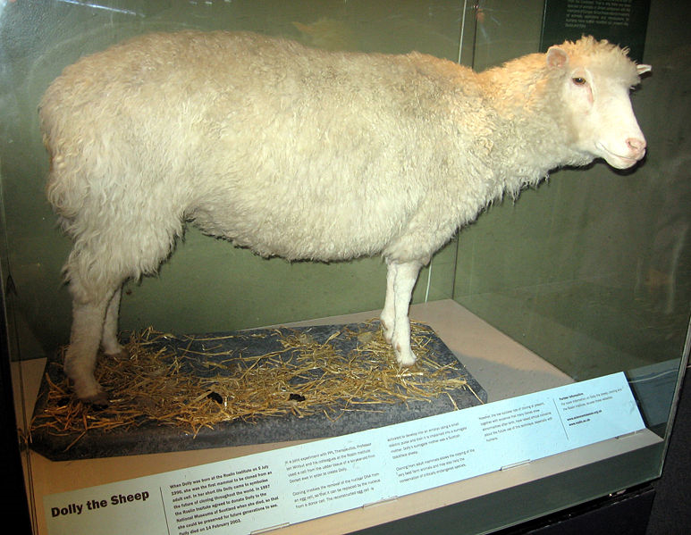
Dolly the Sheep
Notes:
In a Scottish museum

Slide 20
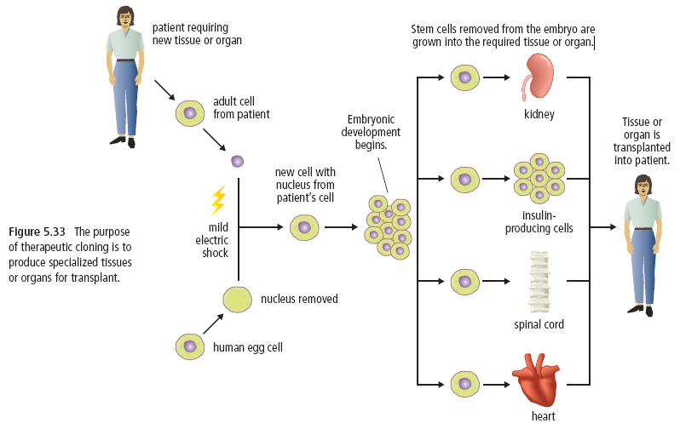
Therapeutic Cloning
-using stem cells to clone healthy organs or tissues such as kidneys, nerves etc.
Notes:
-stem cells have the ability to become many types of cells– they can be used to create healthy cells and thus replace damaged cells in patients with diabetes, spinal injuries or Parkinson’s disease---embryonic stem cells are best but now adult stem cells are also being used

Slide 21
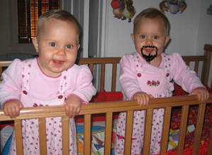
Myths
Nature vs. Nurture – no such thing as a perfect clone (only genetically)
Cloning will not produce a present-self

Slide 22
Discuss the following in groups of 3 or 4
Reasons to clone
Reasons against cloning

Slide 23
Share ideas with class!

Slide 24
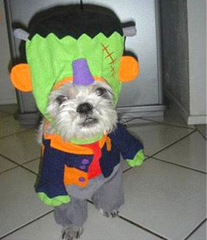
Reasons for Cloning
Stem cells – to replace damaged or missing tissues or organs
Reviving endangered or extinct species
Replacing the dead
Engineering offspring

Slide 25
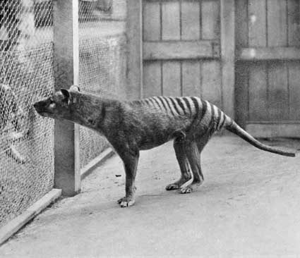
Last known photograph of a Tasmanian Tiger
Scientists have DNA samples – they hope to one day recreate this extinct animal

Slide 26
Reasons Against Cloning
Medical - Will the clone live a healthy, normal life?
Ethical– is it right to play God?
Biological - How will engineering offspring affect our species?
Legal– Who owns the clone? Who is the parent?
Social– What kind of life will the child have?

Slide 27
Unit Summary
Chapter 4 – The nucleus controls the functions of life.
  4.1 The function of the Nucleus within the Cell
  4.2 Mutation
Chapter 5 – Mitosis is the basis of asexual reproduction.
  5.1 The Cell Cycle and Mitosis
  5.2 Asexual Reproduction
Chapter 6 – Meiosis is the basis of sexual reproduction.
  6.1 Meiosis
  6.2 Sexual Reproduction
  6.3 Assisted Reproductive Technologies

Slide 28
Do This!
Key questions
Workbook 5.2
In-class Quiz

