Slide 1
What is a compound? Understanding chemical formulas how do elements chemically bond to form molecules or compounds?
Notes:
Last updated Apr 10, 2014
Buckminsterfullerene (C₆₀) is a molecule with unusual properties that was discovered in the late 1980’s and is being investigated for cancer treatments, skin care carbon nanotubes, and other applications. Several laboratory studies suggest that the water-soluble form of C₆₀ may have neuroprotective properties and the non-hydrated forms dissolved in olive oil might extend lifespan. However, these claims have never been tested in humans. Similarly, the safety of C₆₀ and its derivatives have never been tested in humans.

Slide 2
Elements are made up of only one type of atom.
such as Hydrogen = H₂ or Copper = Cu
Molecules are made up of two or more atoms
such as Cl₂ or CO₂
The molecules of a compound are made up of 2 or more atoms from different elements.
such as K₂S
All atoms of copper are copper and all atoms of hydrogen are hydrogen!
A chlorine molecule consists of 2- Cl atoms while carbon dioxide consists of 1 – C atom and 2 – O atoms
This substance consists of 2 – K atoms and 1 – S atom. Atoms from two different elements!

Slide 3
What is a compound?
2 or more elements joined together by chemical bonds
The substance has different properties than the elements that make it up.
The elements making up the compound exist in specific ratios
Ex. Water = H₂O
Contains:
2 – H atoms & 1 – O atom
2 different elements
2:1 ratio

Slide 4
Chemical formulas of Compounds /Molecules show:
The proportion of each element present in the substance
The elements present in a substance
Number of atoms of each element in the substance
Parentheses may be used to show groups of atoms that stay together and behave as a unit
E.g. CO ₂ =
E.g. Ca(NO₃)₂ =
2 different elements
1 – C and 2 – O = 3 atoms
3 different elements
1 – Ca, 2 – N and 6 – O = 9 atoms
How many atoms are in the following compound: Ca₃N₂?
3 –Ca + 2 – N = 5 atoms

Slide 5
Try the following questions:
1) How many different elements are in the following compound? Al (OH)₃
How many atoms are in this compound?
Three Elements
1 – Al , 3 – O, 3 – H = 7 atoms
2) How many elements different are in the following compound? (NH₄)₃ PO₄
How many atoms are in this compound?
Four Elements
3 – N, 12 – H, 1 – P, 4 – O

Slide 6
2 Types of Compounds
Metal with non-metal vs
Non-metal with non- metal

Slide 7
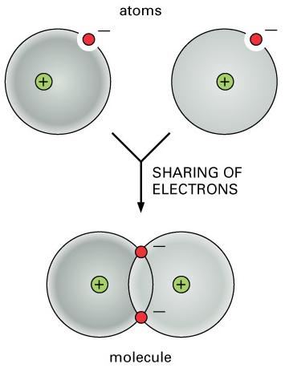
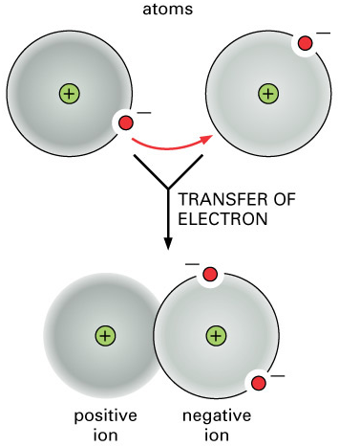
2 Types of Compounds
Covalent
Ionic

Slide 8
2 Types of Compounds
Covalent
Ionic
Electrons shared between two or more non-metal atoms
Form “molecules” a neutral particle made up of atoms joined by covalent bonds.
Bonding due to electron sharing
Electrons transferred from metal to non-metal to create oppositely charged ions
Form “ionic lattice”
Bonding due to attraction between oppositely charged ions (+/-attraction)
Animation→

Slide 9
Covalent Compounds
Non-metals atoms share electrons to form Compounds

Slide 10
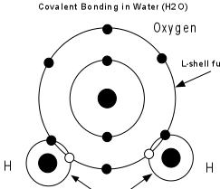
Covalent Bonds
Example 1. H₂O

Slide 11
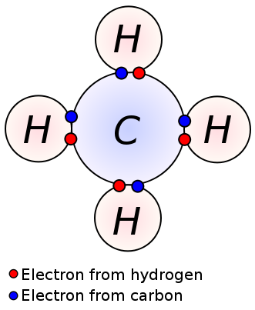
Covalent Compounds
Example 2. CH₄

Slide 12
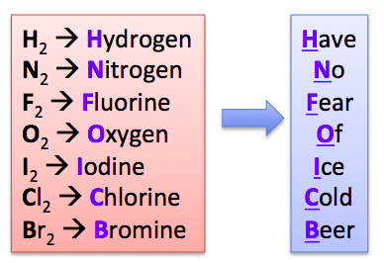
Diatomic Molecules
Non-metal elements that always exist as two atoms of the same element covalently bonded together

Slide 13
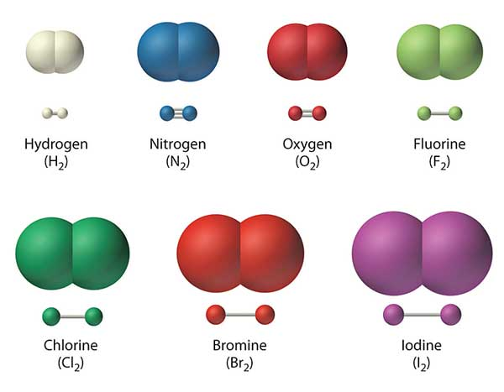
Bonds in Diatomic Molecules are shown as either one, two or three lines. This indicates the number of pairs of electrons covalently bonded!

Slide 14
Ionic Compounds
Metals transfer electrons to Non-metals

Slide 15
Ionic Compounds
Example: NaCl

Slide 16
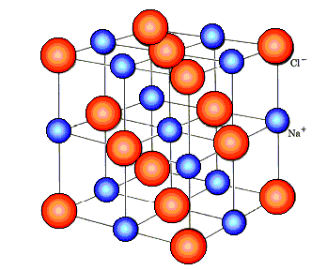
Ionic Compounds
Positively charged sodium ions are attracted to negatively charged chloride ions
Ions come together to form an ionic lattice

Slide 17
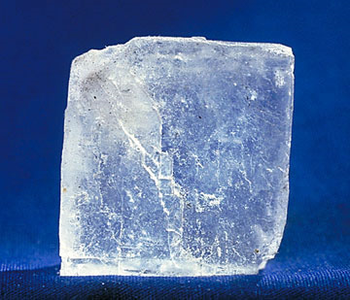
Ionic Compounds
All positive ions attract all negative ions to form a crystal (eg. grains of salt)

Slide 18
Polyatomic Ions
A charged group of atoms that are held together with covalent bonds is called a polyatomic ion.

Slide 19
Polyatomic Ions
A group of different atoms bonded chemically to each other that has a charge

Slide 21
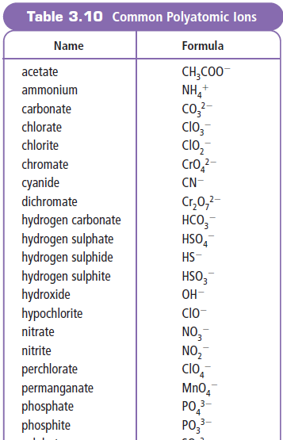
Common Polyatomic Ions

Slide 22
Examples:
Ionic Compound
NaCl
Covalent Compound
H₂O
Ionic compound containing a Polyatomic Ion
CaSO₄

Slide 23
DO THIS!
Refer to text pgs. 76 – 80
Complete Comparison Sheets
Complete Ions vs Atoms vs Compounds sheet!

