Slide 1
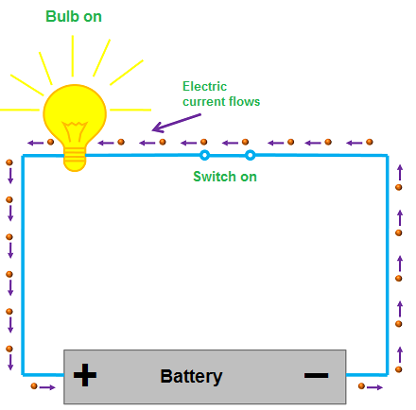
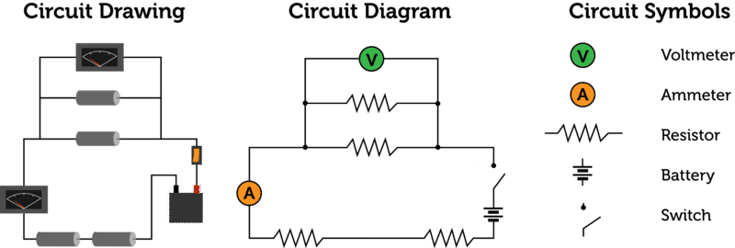
Electricity current, Circuits and Schematic Diagrams
Notes:
Click on button for story on backyard Tesla coil (YouTube)
Nikola Tesla dreamed of creating a way to supply power to the world without stringing wires across the globe. The inventor came close to accomplishing this when his "mad scientist" experiments with electricity led to his creation of the Tesla coil.
The first system that could wirelessly transmit electricity, the Tesla coil was a truly revolutionary invention.

Slide 2
Learning Goals:
Elec 2 - I can explain factors influencing current flow and how electrons flow through components in a circuit
Elec 3 – I can describe different types of circuits and draw schematic diagrams showing components and electron flow

Slide 3
Types of Electricity
Static electricity forms when charges build up and remain on an object for a while.
Current electricity forms when electrons flow through a circuit

Slide 4
What is Current Electricity?
The flow of negatively charged particles called electrons in a complete circuit.
-
+
http://phet.colorado.edu/en/simulation/travoltage

Slide 5
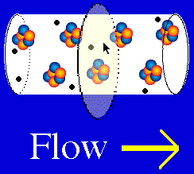
Electric current (I) – flow of charge
Amount of charge passing through a set point every second
Higher the current, the faster the electrons move
Unit of measure = amperes (A) or milliamps (mA);
1.0 A = 1000 mA
1 A = 1coulomb/1 second (1 Coulomb is $6.24×{10}^{18}$ electrons)
Measured with a device called an Ammeter
Analogy: How fast the water in a river flows is like current flow in an electrical cable

Slide 6
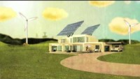
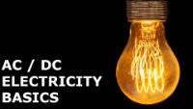
AC Vs DC Circuits
Electric Circuit: A complete pathway that allows electrons to flow from the source and back again.
Record your own notes while viewing videos on Alternating Current vs Direct Current
Intro Video EngineeringMindSet

Slide 7
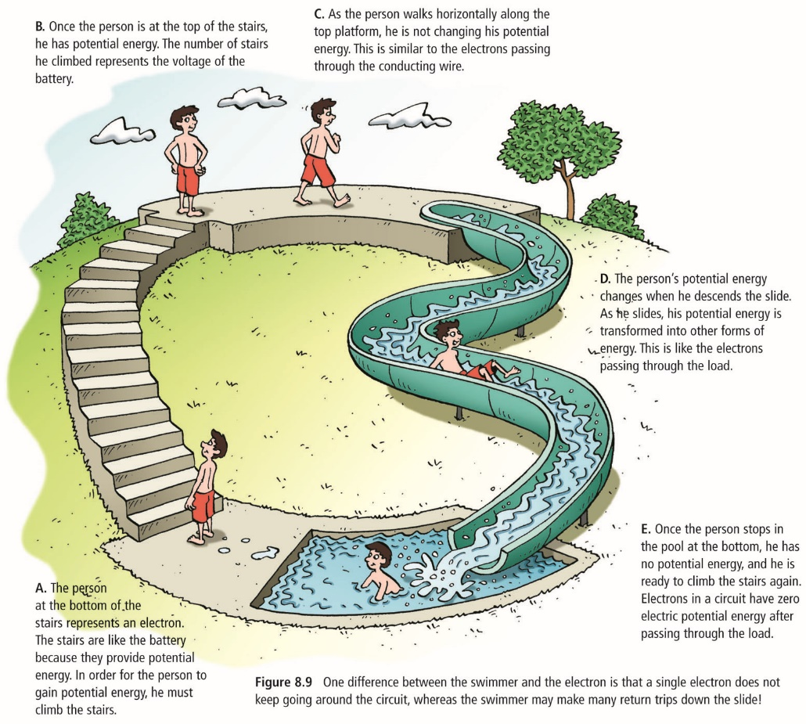
Water slide Electric Circuit Analogy
The person represents an electron in a circuit
Stairs are the battery – the source of potential energy (number of stairs is the voltage)
Potential energy lost only when person slides down – like when electrical energy transformed to other forms of energy by a load i.e. light bulb uses electricity to produce light and heat
At bottom electron/person has zero potential energy remaining

Slide 8
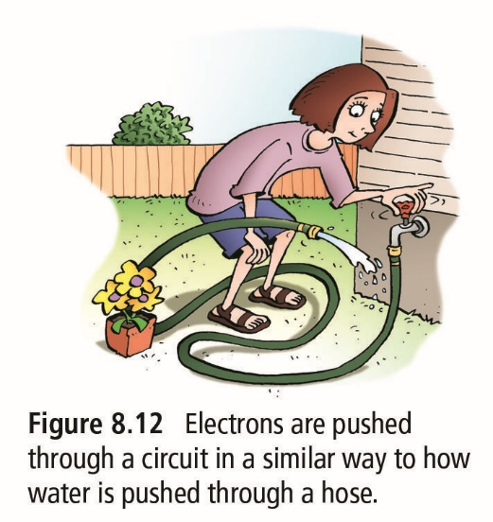
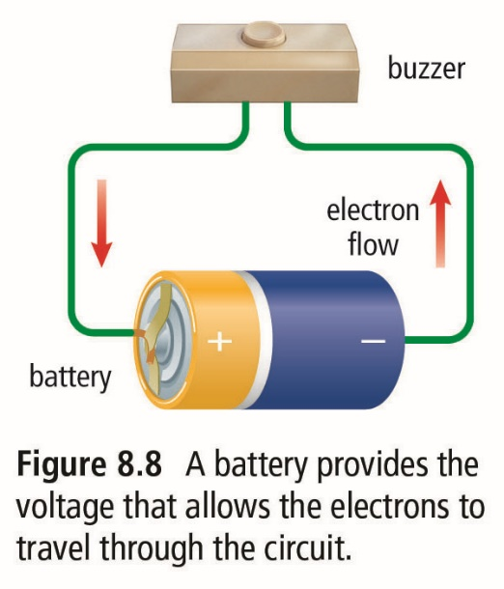
CIRCUIT COMPONENTS: Four basic parts!
A source such as a battery or solar panel that provides the electrical energy to push electrons through a circuit. The amount of push determines a cells voltage.
Conductor: Wires provide a pathway for the electrons to flow
Load: a device that transforms electrical energy into other forms of energy i.e. motor, light bulb, heater, buzzer
Switch: a device that can stop the flow of electrons by closing or opening a circuit

Slide 9
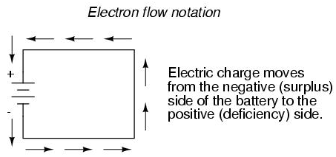
Electron Flow in a circuit
Electrons flow from –ve to +ve terminals in a closed circuit!
There are two main types of circuits: Series and parallel circuits
e

Slide 10
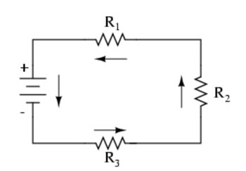
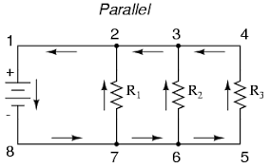
Series: Current has only one pathway through all parts of the circuit.
Series Circuit – Electron flow
Parallel Circuit – Electron flow
Parallel: Current can flow through multiple pathways in the circuit.

Slide 11
Phet Exploration Activity - insulators vs conductors -circuit components -electron flow in simple circuits -intro to circuit diagrams

Slide 12
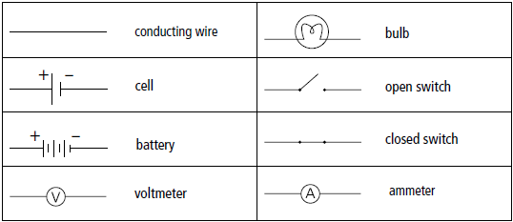
Drawing schematic Diagrams

Slide 13
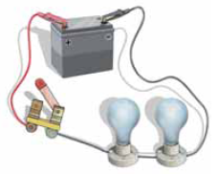
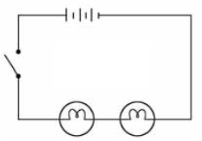
Circuit Diagram Examples

Slide 14
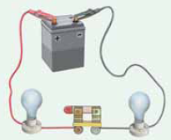
Circuit Diagram Examples
On your own: Draw the schematic diagram
With your partner: Agree on the correct diagram

Slide 15
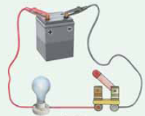
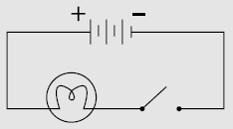
Circuit Diagram Examples
On your own: Draw the schematic diagram
With your partner: Agree on the correct diagram

Slide 16
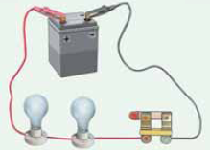
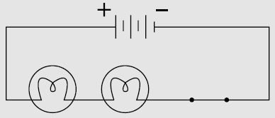
Circuit Diagram Examples
On your own: Draw the schematic diagram
With your partner: Agree on the correct diagram

Slide 17
COMPLETE THE HANDOUTs on drawing Circuit Diagrams

