Slide 1
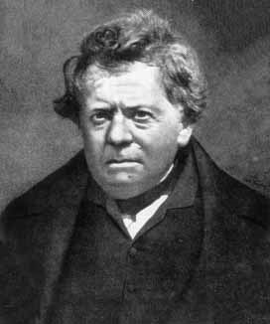
Ohm’s Law
V = I R
Georg Ohm

Slide 2
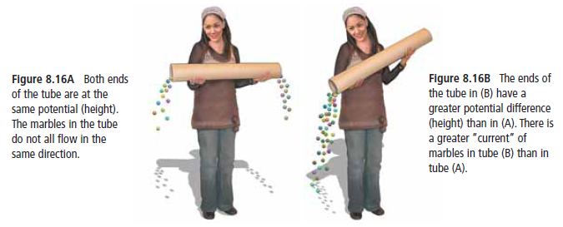
How is voltage related to current?
The amount of current that flows through a wire depends on the voltage. The greater the voltage the faster the charges flow.
V = IR
If ↑ V then ↑ I
If ↓ V then ↓ I

Slide 3
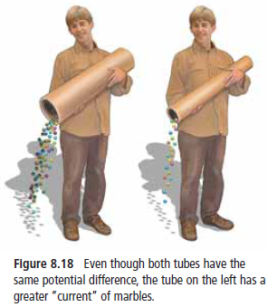
How is Current related to Resistance?
Amount of current also depends on how the wire resists the flow of the charge.
V = IR or I = $\frac{V}{R}$
If ↓ R then ↑ I
If ↑ R then ↓ I

Slide 4
Summary - Last slide before notes on Ohm’s Law Calculations
The unit for resistance is called the Ohm (Ω)
The relationships between voltage(V), current(I), and resistance(R):
V = I R
in Volts (V)
in Amperes (A)
in Ohms (Ω)

Slide 5
DO THIS!
Textbook pages 293, 294 #1-3 on both!
Text: Pg. 301 #8 – 13 (omit 11)
Text: Pg. 303 #26 – 31 (omit 30)
Calculating Resistance Problems! For marks!

Slide 6
Warm –up use Ohm’s Law V=IR to complete Table By Finding unknown in each row. Show Steps! Convert using conversion factors where needed!
I (amps) | V (volts) | R (ohms)
I= ? A | 12 V | 75 Ω
15 A | 0.24 kV→ Volts? | R=? Ω
5500 mA→Amps? | V=? V | 20

Slide 7
Ohm’s Law Problem
A vacuum cleaner is plugged into a 120 V outlet. The vacuum cleaner is rated at 12000 mA. What is the resistance of the motor and circuitry of the vacuum?

Slide 8
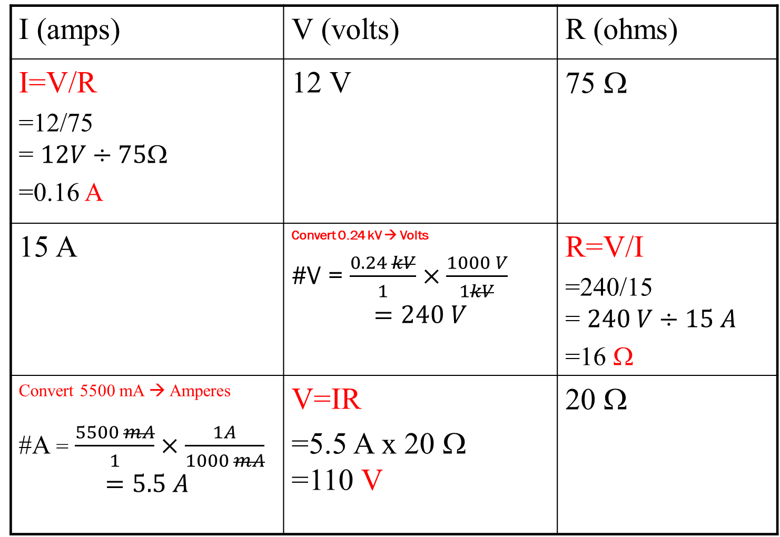
Key – Warm-up Ohm’s Law
I (amps) | V (volts) | R (ohms)
I=V/R =12/75 = $12V÷75$Ω =0.16 A | 12 V | 75 Ω
15 A | Convert 0.24 kV → Volts #V = $\frac{0.24 kV}{1}×\frac{1000 V}{1kV}$ $$=240 V$$ | R=V/I =240/15 = $240 V÷15 A$ =16 Ω
Convert 5500 mA → Amperes #A = $\frac{5500 mA}{1}×\frac{1A}{1000 mA}$ $$=5.5 A$$ | V=IR =5.5 A x 20 Ω =110 V | 20 Ω

Slide 9
Doing the Work
Thinking Steps
Identify the known variables.
Identify all the unknown variables.
Adjust formula to solve for unknown.
Convert all values to standard units. Volts (V)–Ohms (Ω) - Amperes(A)
Substitute the numbers into the formula and solve.
Voltage (V) = 120 V Current (I) = 12000 mA
Resistance (R) = ?
V = IR → $\frac{I R}{I}=\frac{V}{I} →R =\frac{V}{I}$
12000 mA X $\frac{1 A}{1000 mA}$ = 12 A
$$R=\frac{V}{I} =\frac{120V}{12A}=10 $$

