Slide 1
Review

Slide 2
Instructions
Grab a white board
For each compound given either write the formula or name the compound. Remember to include Roman numerals for multivalent ions

Slide 3
tetrachlorine trisulphide

Slide 4
tetrachlorine trisulphide
Answer: Cl₄S₃

Slide 5
iron (II) oxide

Slide 6
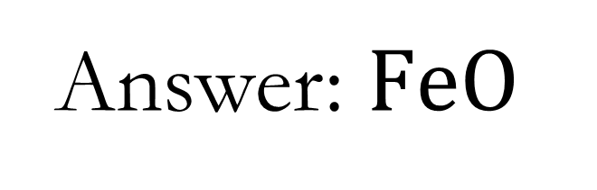
iron (II) oxide
Answer: $FeO$

Slide 7

$${Li}_{3}P$$

Slide 8

$${Li}_{3}P$$
Answer: lithium phosphide

Slide 9
CH₇

Slide 10
CH₇
Answer:
carbon heptahydride

Slide 11
barium nitride

Slide 12
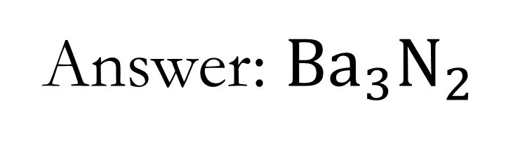
barium nitride
Answer: ${Ba}_{3}N_{2}$

Slide 13
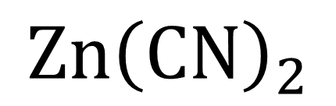
$$Zn{\left(CN\right)}_{2}$$

Slide 14
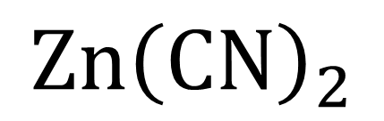
$$Zn{\left(CN\right)}_{2}$$
Answer: zinc cyanide

Slide 15
I₁₀O

Slide 16
I₁₀O
Answer:
decaiodine monoxide

Slide 17
For: lead (II) nitrate
List ions and balance
Write ion ratio
Give chemical formula

Slide 18
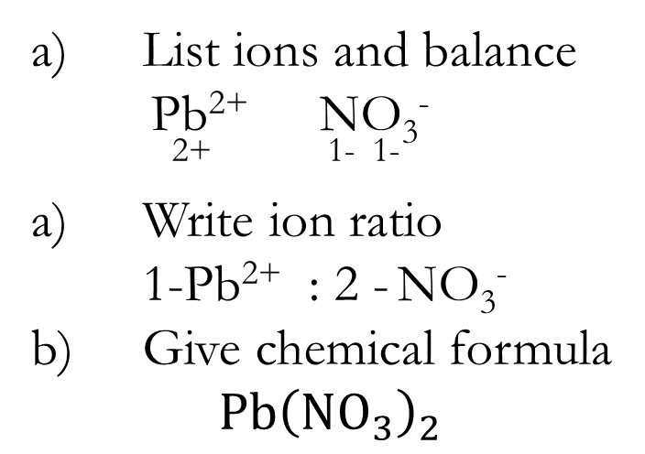
lead (II) nitrate
List ions and balance
Pb²⁺ NO₃⁻
²⁺ ¹⁻ ¹⁻
Write ion ratio
1-Pb²⁺ : 2 - NO₃⁻
Give chemical formula
$$Pb{\left(NO_{3}\right)}_{2}$$

Slide 19

Which elements are in the following compound?
$${\left(NH_{4}\right)}_{2}Cr_{2}O_{7}$$

Slide 20

Answer:
$$Nitrogen, Hydrogen, \\ Chromium and Oxygen$$

Slide 21

How many atoms are in the following compound?
$${\left(NH_{4}\right)}_{2}Cr_{2}O_{7}$$

Slide 22
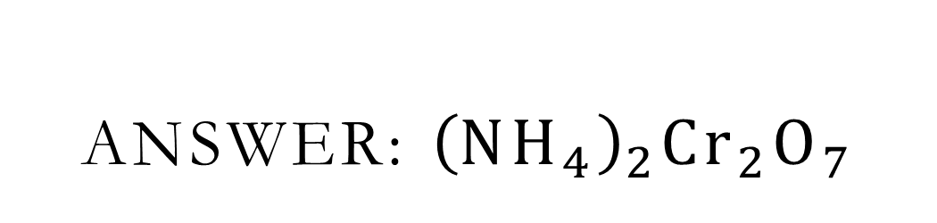
Answer: ${\left(NH_{4}\right)}_{2}Cr_{2}O_{7}$
2- N; 8 –H; 2-Cr; 7-O = 2+8+2+7 = 19 atoms

Slide 23

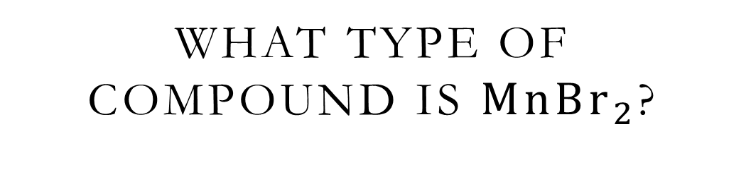
What type of compound is $MnBr_{2}$?
$$\text{How} \text{do} \text{you} \text{know}\text{?}$$

Slide 24
Answer:
Ionic – metal bonded with a non-metal

Slide 25

List ions in the compound and balance charges to determine chemical name
$$MnBr_{2}$$

Slide 26
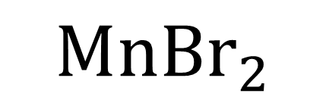
$$MnBr_{2}$$
Answer: Mn^{2+ or 3+ or 4+} Br⁻
²⁺ ⁻ ⁻
^{1x2=+2 2 x-1 =-2}
manganese (II) bromide

Slide 27
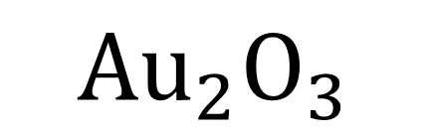
$$Au_{2}O_{3}$$

Slide 28
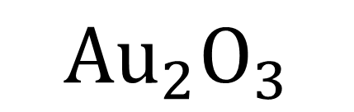
$$Au_{2}O_{3}$$
Answer: gold (III) oxide

Slide 29
octaphosphorus difluoride

Slide 30
octaphosphorus difluoride
Answer: P₈F₂

Slide 31
How do you know the following compound is covalent?
NH₃

Slide 32
Answer:
Nitrogen and Hydrogen are both non-metals.
No ions are formed to create chemical bond!
Electrons are shared to complete valence shells!

Slide 33
ammonium dichromate

Slide 34
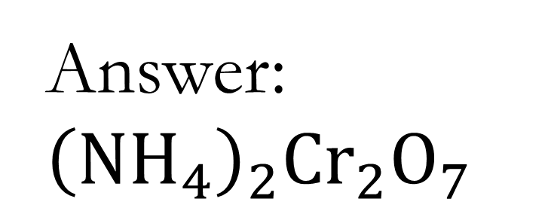
Ammonium dichromate
Answer: ${\left(NH_{4}\right)}_{2}Cr_{2}O_{7}$

Slide 35
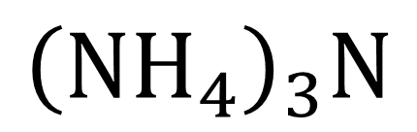
$${\left(NH_{4}\right)}_{3}N$$

Slide 36
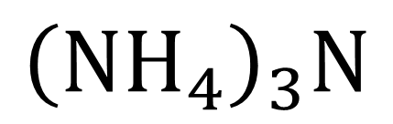
$${\left(NH_{4}\right)}_{3}N$$
Answer:
ammonium nitride

Slide 37
Name this: N_{2 (g)}

Slide 38
N₂
Answer: Nitrogen gas
What type of substance is this?
What type of bound exists between the nitrogen atoms?

Slide 39
What type of substance is this?
Diatomic molecule
What type of bound exists between the nitrogen atoms?
Covalent as two non-metals sharing electrons in valence shell

Slide 40
cobalt (III) permanganate

Slide 41
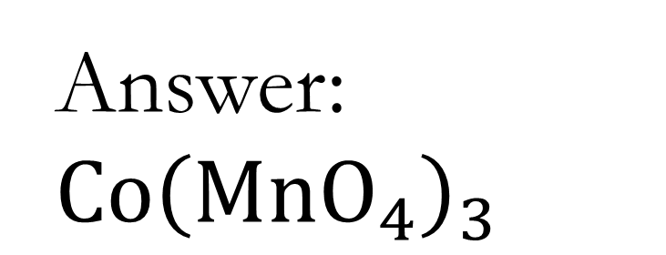
Cobalt (III) permanganate
Answer: $Co{\left(MnO_{4}\right)}_{3}$

Slide 42

$$KI$$

Slide 43

$$KI$$
Answer:
potassium iodide

Slide 44
sodium chlorate

Slide 45
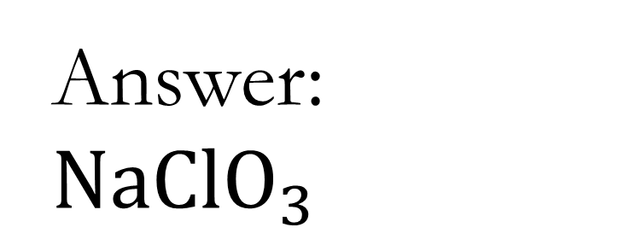
sodium chlorate
Answer: $NaClO_{3}$

Slide 46
copper (II) phosphate

Slide 47
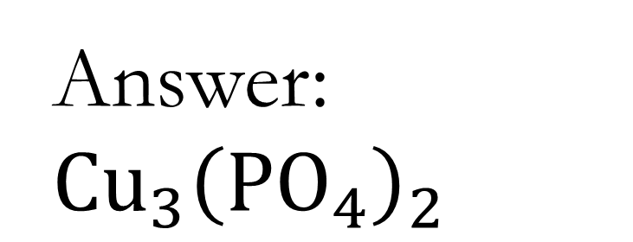
copper (II) phosphate
Answer: $Cu_{3}{\left(PO_{4}\right)}_{2}$

Slide 48
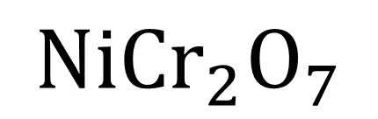
$${NiCr}_{2}O_{7}$$

Slide 49
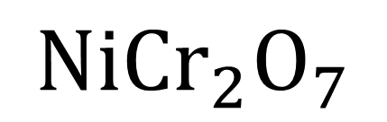
$${NiCr}_{2}O_{7}$$
Answer:
nickel (II) dichromate

Slide 50
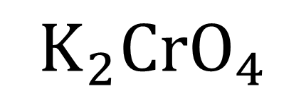
$$K_{2}{CrO}_{4}$$

Slide 51
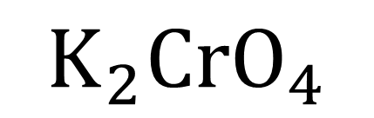
$$K_{2}{CrO}_{4}$$
Answer:
potassium chromate

Slide 52
hydrogen acetate

Slide 53
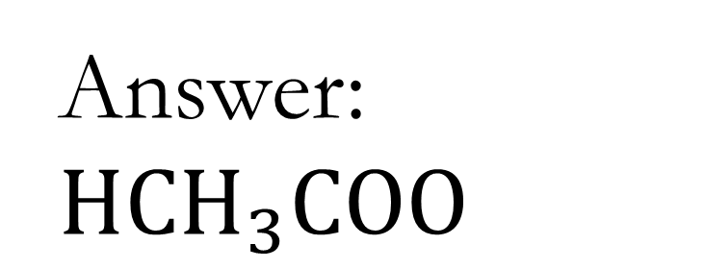
hydrogen acetate
Answer: $HCH_{3}COO$

Slide 54
calcium iodide

Slide 55
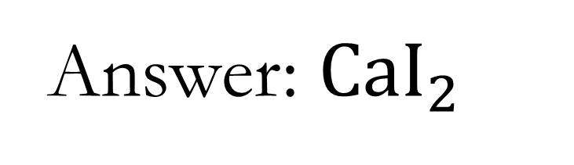
calcium iodide
Answer: $CaI_{2}$

Slide 56

$$MnP$$

Slide 57

$$MnP$$
Answer:
manganese (III) phosphide

Slide 58
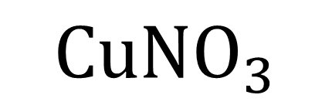
$${CuNO}_{3}$$

Slide 59
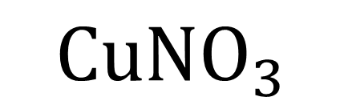
$${CuNO}_{3}$$
Answer:
copper (I) nitrate

Slide 60
iron (III) sulphate

Slide 61
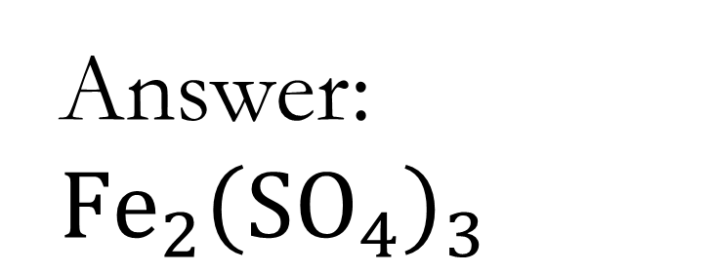
iron (III) sulphate
Answer: $Fe_{2}{\left(SO_{4}\right)}_{3}$

