Slide 1
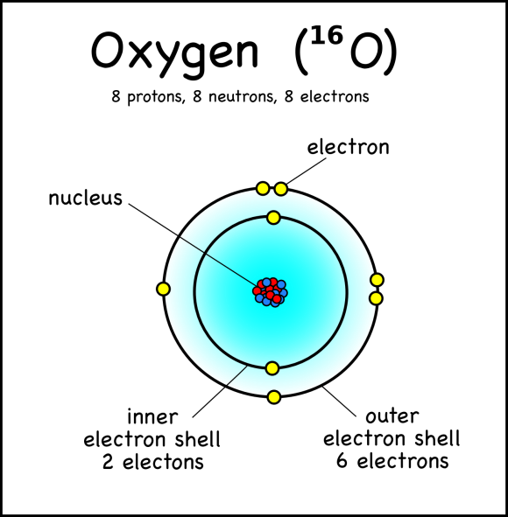
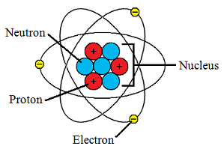
The Building Blocks of Matter are Atoms
What are atoms made of and what is their structure? What did we learn about matter and atoms through the development of the atomic theory?

Slide 2
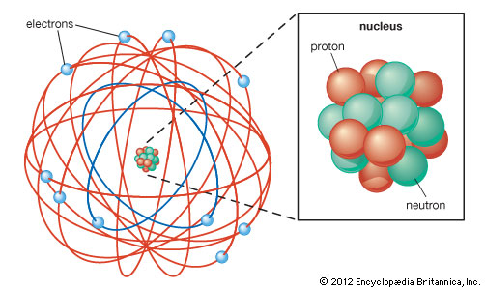
Planetary Model
Clearly Stated -What are atoms made of
https://www.youtube.com/watch?v=ooWfzpUIoNM

