Slide 1
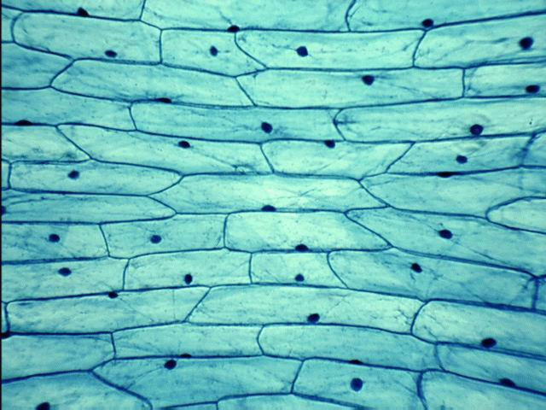
The Cell Cycle and MITOSIS
Notes:
Introduction. Will automatically lead into the next slide.

Slide 2
Cells Divide to Make Identical Copies:
Why?:
a) Repair/replacement of body tissue/cells
b) Growth of organism
c) Reproduction by some asexual organisms

Slide 3
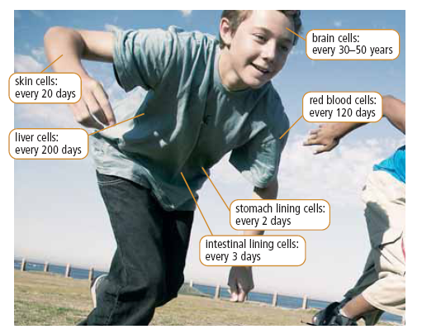
Cells die and need replacing!

Slide 4
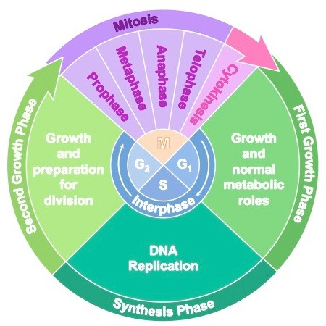

Slide 5
Cell Cycle Includes
1) Interphase
2) Mitosis
3) Cytokinesis

Slide 6
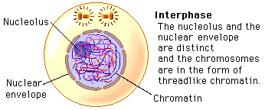
Interphase - longest phase of the cell cycle where cell carries out important functions necessary for survival and prepares for cell division
Cell increases in size
Organelles are duplicated
DNA is replicated and exists as chromatin -loosely coiled strands of DNA

Slide 7
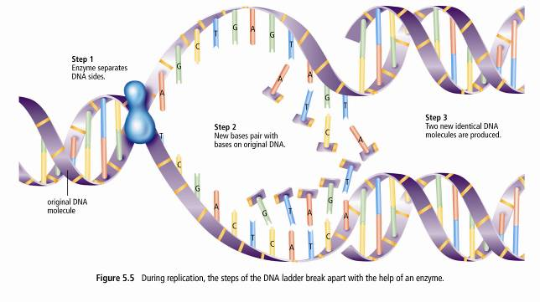
Replication of DNA
DNA gets copied!

Slide 8
2) Mitosis: Nuclear Division
Stages of Mitosis: PMAT (prophase, metaphase, anaphase, telophase)

Slide 9
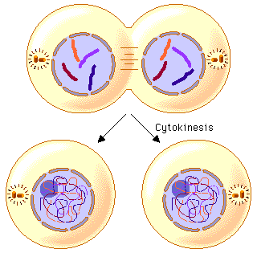
3) CYTOKINESIS – Cell division
Cytokinesis is the splitting of cytoplasm
In animals the cell membrane pinches in middle dividing the cell into two.
In plants a cell plate grows across the middle of cell, resulting in the formation of cell walls between two daughter cells.
Notes:
Cytokinesis begins around anaphase and is the splitting of the cytoplasm, mitosis is mainly the replication of the DNA.
Click the return button to return to the mitosis contents page, or the house button to return to the main menu.

Slide 10
The Result of Cell Division
Two identical daughter cells that have the same number of chromosomes as the parent cell!
http://www.youtube.com/watch?v=gwcwSZIfKlM

Slide 11
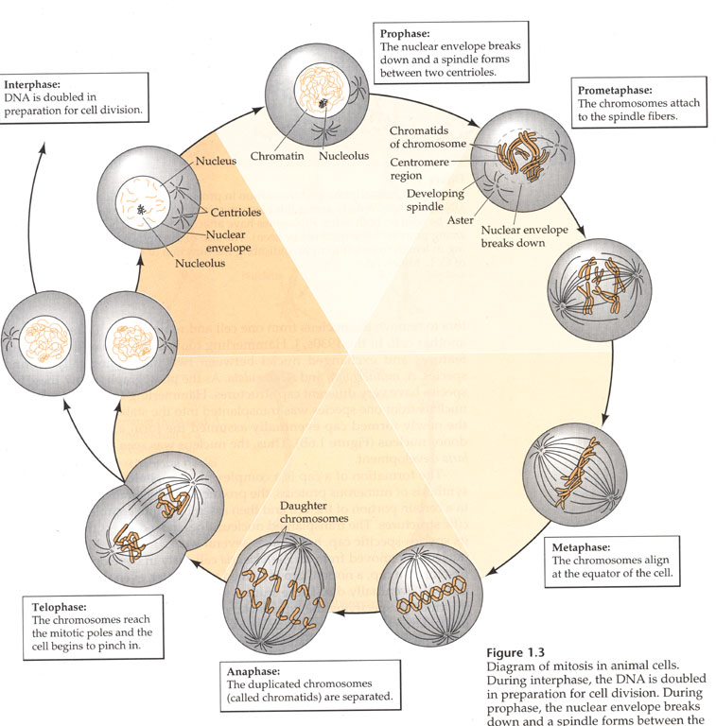
The Cell Cycle Stages!
Mitosis
Interphase
Interphase
Cytokinesis

Slide 12
Mitosis 3D

Slide 13
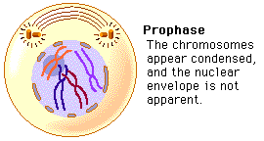
Completion of Notes:
1) Complete the blanks in handout using the following terms: Some terms could be used more than once!
straight, pole(s), reform, chromatin, centrioles, sister, centromere, disappear, contraction of spindle fibres, chromatids, separate, opposite, X-shaped, nucleus, middle, cytokinesis, anaphase, telophase, middle, prophase, break down, chromosomes, spindle, two, nuclear
2) Sketch 4 chromosomes at each stage and the important cell structures involved in that stage of MITOSIS. Illustrate what the cell looks like at each stage (in boxes). Refer to textbook/internet!
Use pencil crayons! Colour each chromosome a different colour. Like in the diagram

Slide 14
Do This!
Complete Mitosis Worksheet

