Slide 1
Matter and its Properties

Slide 2
What is Matter? Sort the following into the appropriate column.
Matter
Not Matter

Slide 3
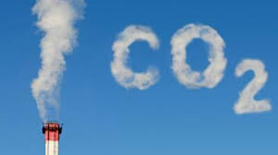
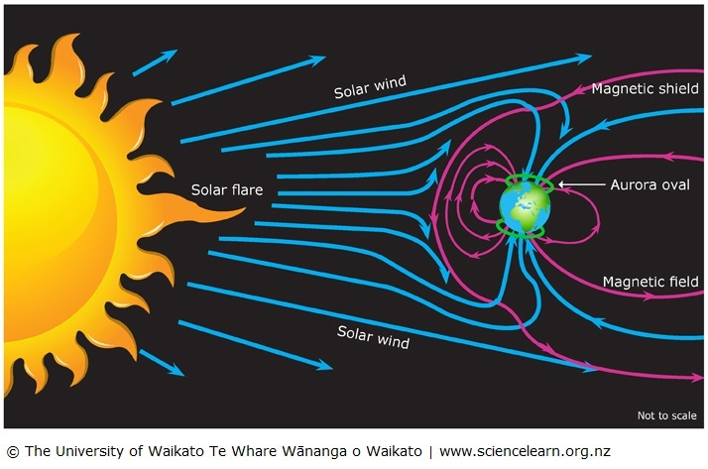
Emotions
Bacteria
Time

Slide 4
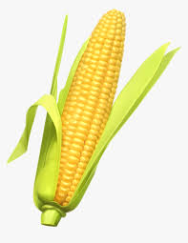
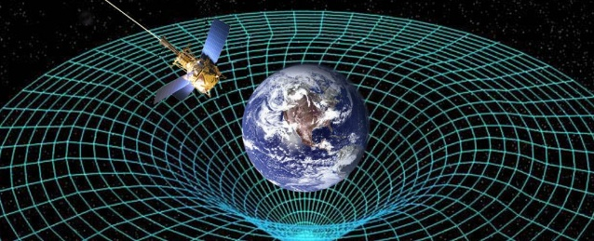
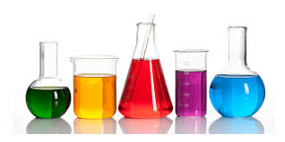
Gravity
Light
Corona virus
Plasma
Chemicals

Slide 5
What is matter? Organize the following terms into the web.
Matter compounds homogeneous pure substances mixtures atoms elements heterogeneous
Has volume and mass
MATTER
Composition varies
PURE SUBSTANCES
Definite composition
MIXTURES
HOMOGENEOUS
118
HETEROGENEOUS
COMPOUNDS
ELEMENTS
Building blocks of matter
ATOMS

Slide 6
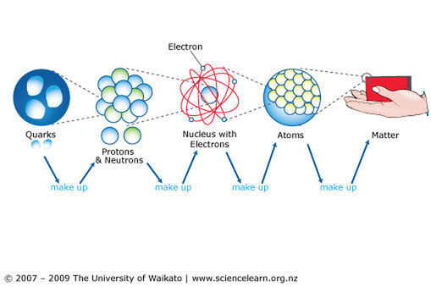
Matter is anything that takes up space and has mass -made up of smaller particles with distinct characteristics
Elements
Type affects properties
make up

Slide 7
Matter can divided into two main groups Mixtures and Pure Substances.
Mixtures – two or more substances mixed together in any proportions
There are two basic types of mixtures:
In heterogeneous mixtures, you can see the different aspects that make up the mixture and they can be separated (think of a salad).
In a homogenous mixture, components tend to completely mix together and you are unable to see the different components (think about dissolving sugar in water)

Slide 8
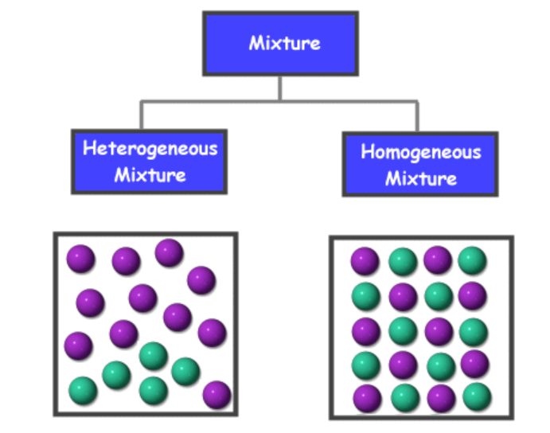
Sort the following into the correct type of mixture: honey, blood, assortment of dried fruit, steel, soil, medicine, chicken noodle soup, milk, oil and vinegar dressing, granola
 | Honey
Assortment of dried fruit
Soil
Chicken Noodle Soup
Oil and vinegar dressing
Granola
Honey
Blood
Milk
Steel
Medicine such as tylenol

Slide 9
Pure Substances –a substance made up of only one kind of particle with the same properties throughout.
Element – An element is a substance that consists entirely of one type of atom. An atom is the smallest amount of an element that retains the properties of the element.
Name 2 elements
Compound – Is a substance composed of at least two different elements chemically combined in specific proportions.
Name 2 compounds

Slide 10
Try This: Identify substance as either a pure substance (pure) or a mixture (Mix – Hetero/Homo). If you know type of pure substance indicate this as well!
a. table salt b. baking soda c. copper d. soup e. gasoline f. water g. nitrogen gas h. whipped cream i. fluorine
Pure – compound (NaCl) Pure – compound (NaHCO₃) Pure - element Heterogeneous mixture Homogeneous mixture Pure -Compound (H₂O) Pure – element - N₂ Homo - Mixture – air and cream Pure – element - F

Slide 11
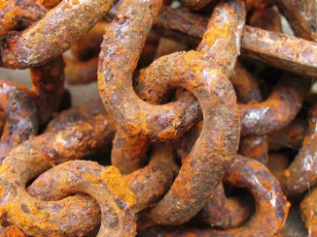
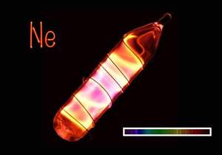
Describing matter: Elements that make up matter have both chemical and physical properties
Chemical Property- the ability of a substance to react with another substance to form one or more new substances with new properties.
Reactivity and flammability are two chemical properties.
For example:
Oxygen is reactive and forms rust with many metals
Neon in an inert gas that does not like to react with anything

Slide 12
Physical Properties – characteristics of matter that can be observed or measured. For Example: states of matter
What are the four physical states of matter?
What causes substances to change Physical State?
What two things happen to particles in a substance when the substance changes state?
1)__________________________________________ 2)__________________________________________
Solid, Liquid, gas and plasma
Heating or cooling the substance
Particles move faster or slower
Particles move closer or further apart

Slide 13
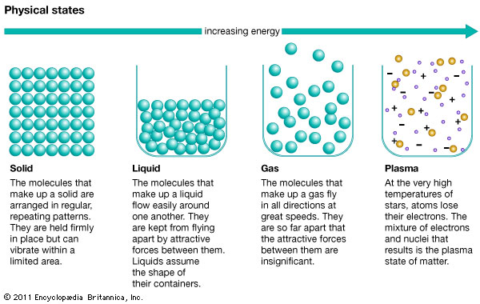
Notes:
Molecules should be replaced with particles or atoms because not all materials are made from molecules (two or more atoms bonded together chemically)

Slide 14
Some other physical properties of matter are density, colour, malleability, ductility, crystallinity, magnetism, solubility, conductivity, viscosity, melting/freezing point and boiling/condensing point
Match these terms with the appropriate description and complete the table! Use the internet to look up terms you do not know.

Slide 15
Match physical property with description:
Physical Property | Description
 | Appearance of reflected light
 | Ability to dissolve in water
 | Resistance to flow of a liquid
 | Temperature of melting/freezing
 | Ability to be beaten into sheets
 | Ratio of a material’s mass to its volume
 | Tendency to be attracted to a magnet
 | Ability to be drawn into wires
 | Temperature of boiling/condensing
 | Ability to conduct electricity
 | Shape or appearance of crystals
Colour
Solubility
Viscosity
Melting/freezing point
Malleability
Density
Magnetism
Ductility
Boiling point Conductivity
Crystallinity

Slide 17
Do This!
Use the internet to learn about the reactivity and some physical properties of the following substances.
Properties to Research | Silver | Iron | Sodium | Bromine
How Reactive am I? (very, mildly, rarely) –Name two compounds formed with element listed.
Are compounds easily formed with Oxygen? Yes, No or Sometimes – Give an example!
Electrical conductivity Poor, Good, Excellent
Density (units)
Melting point/Freezing point (°C)
State at room temperature (25°C) Solid, Liquid or Gas

